Slide 1
Chapter 14
Moving Out: Invasion（侵袭）and Metastasis（转移）
Dec 22, 2023

Slide 2
Outline of this lecture
Invasion, metastasis---key steps
EMT and carcinoma metastasis, embryogenesis
mechanism and key regulators
lymphatic vessels in metastasis
Mechanism for metastasis site tropism
Bone metastasis

Slide 3
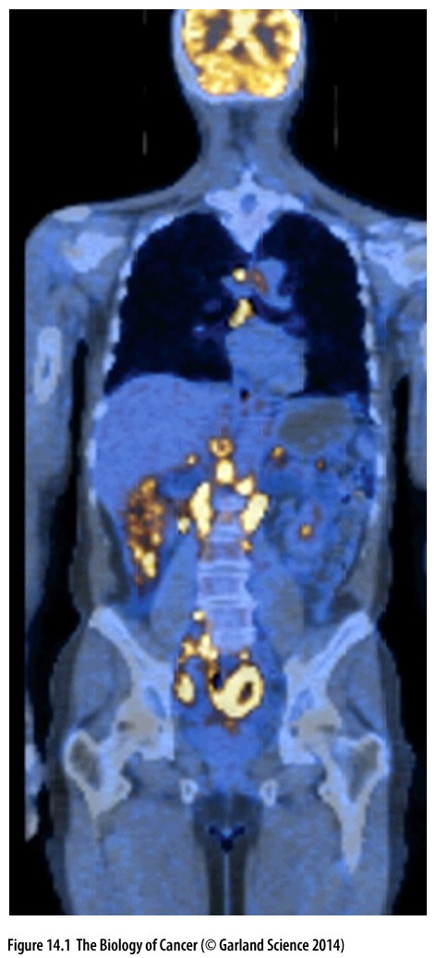
Figure 14.1 Disseminated tumors
Seen here is a whole-body scan of a patient with metastatic non-Hodgkin’s lymphoma (NHL). This is a fusion image of a CT (computed X-ray tomography) scan of the body’s tissues (gray, blue) and a PET (positron-emission tomography) scan in which the uptake of radioactively labeled fluorodeoxyglucose (FDG) in various tissues (yellow) has been detected. FDG uptake indicates regions of high glucose uptake associated with aerobic glycolysis (see Section 2.6). The activity associated with the brain is normal. However, the yellow spots in the abdominal regions indicate multiple NHL metastases.

Slide 4
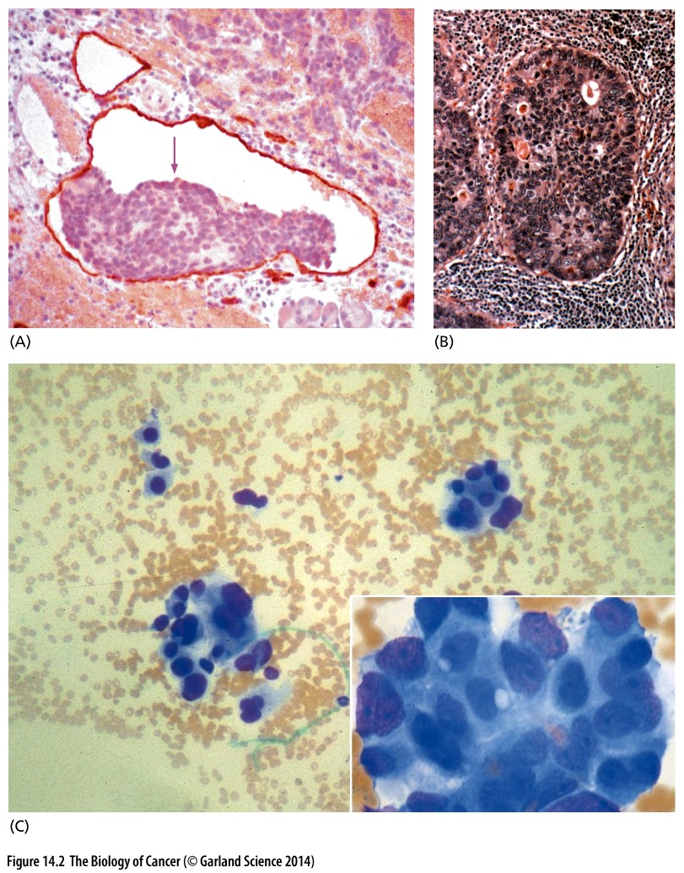
Figure 14.2 Histology of metastases in various tissues throughout the body

Slide 5
14.1 Travel of cancer cells from a primary tumor to a site of potential metastasis depends on a series of complex biological steps

Slide 6
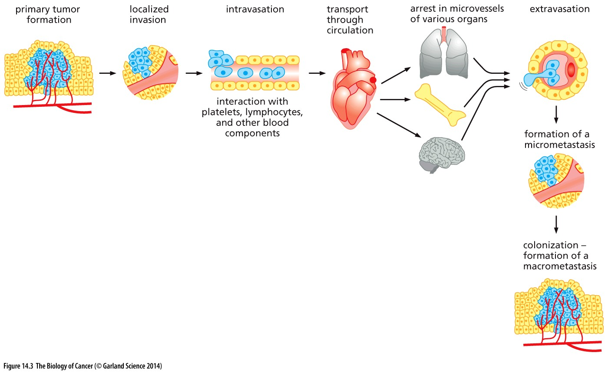
Figure 14.3 The invasion–metastasis cascade
溢出血管
渗入血管
Critical step/EMT
Most complex and challenging step

Slide 7
The great majority (>80%) of life-threatening cancers occur in epithelial tissues, yielding
carcinomas. Consequently, most of our discussions in this chapter, as in the last,
will refer to this class of tumors, with the understanding that cancers arising in other
tissue types, such as connective and nervous tissues, often follow similar paths when
they become invasive and metastatic.
By definition, carcinomas begin on the epithelial side of the basement membrane and are considered to be benign as long as the cells forming them remain on this side.
before carcinoma cells breach the basement membrane, they often succeed in stimulating angiogenesis on the stromal side of the membrane

Slide 8
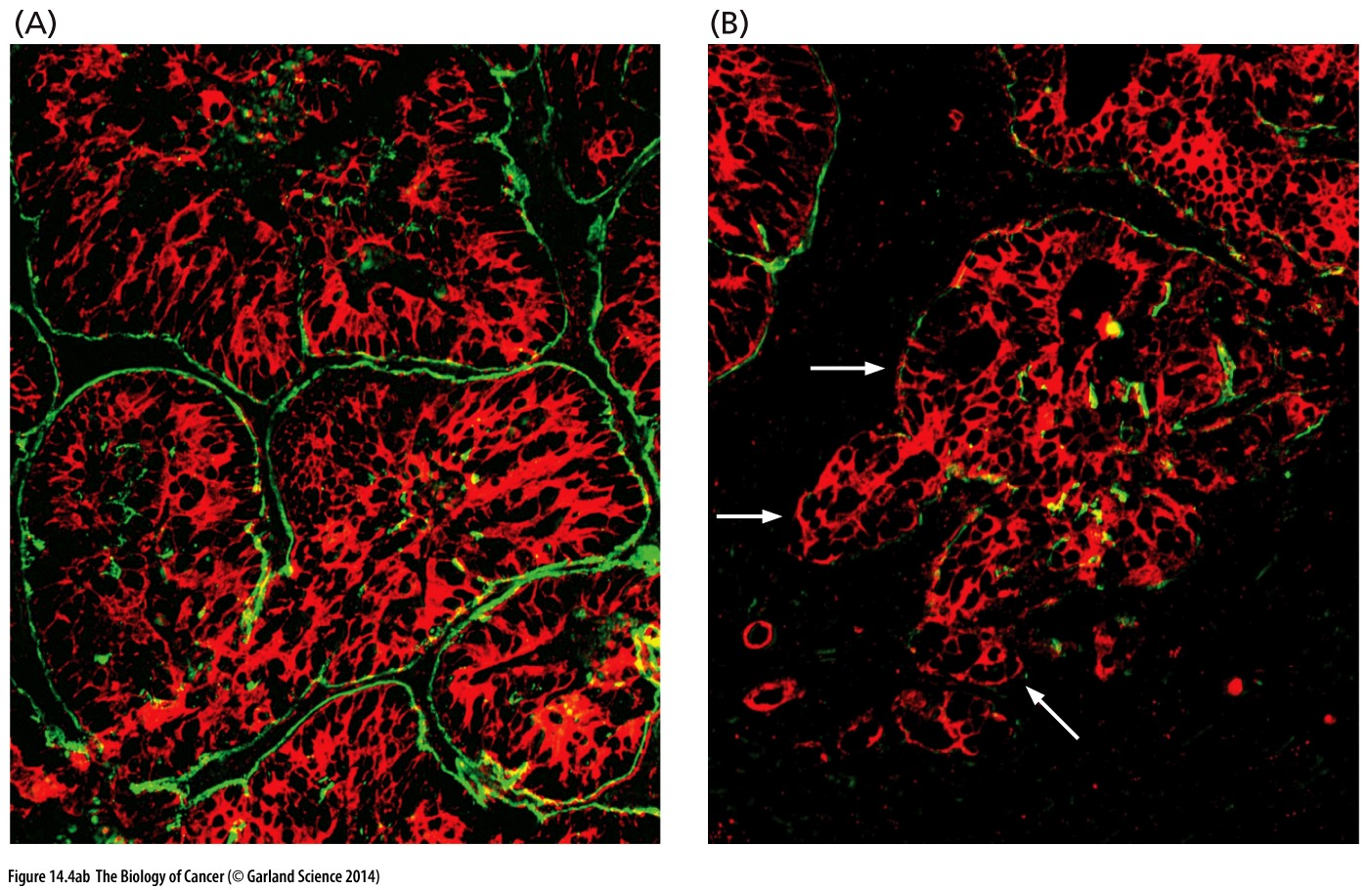
Figure 14.4 Breaching of the basement membrane
The basement membrane (BM) can be detected through use of antibodies reactive with laminin. (A) In the more differentiated, less aggressive portions of a colorectal carcinoma, islands of carcinoma cells labeled with an anti-cytokeratin antibody (red) are surrounded by BMs (green). (B) In the portions of the tumor that appear to be less differentiated and more invasive, this staining reveals edges of islands of carcinoma cells (arrows) that lack BM and thus are directly apposed to the surrounding stroma.

Slide 9
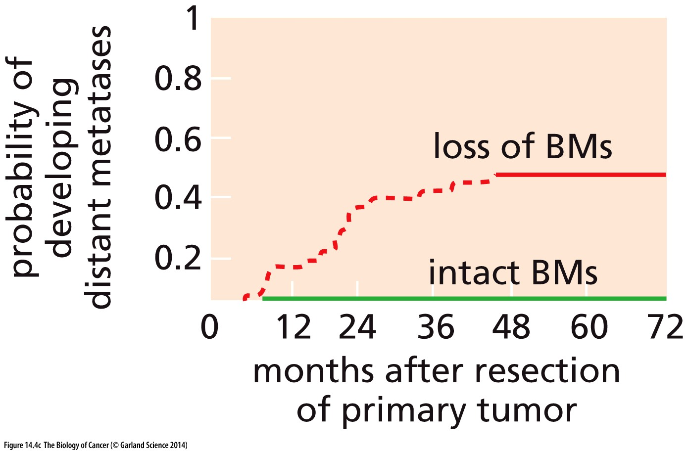
(C) For a group of patients whose high-grade rectal carcinomas (all classified as stage T3) had penetrated at least 5 mm into nearby fatty tissue, the loss of BM around tumor islands directly correlated with the probability of developing distant metastases. Partial
or complete loss of BM within their tumors indicated a strong likelihood that metastases would develop during the five years after surgical removal of the primary tumors.

Slide 10
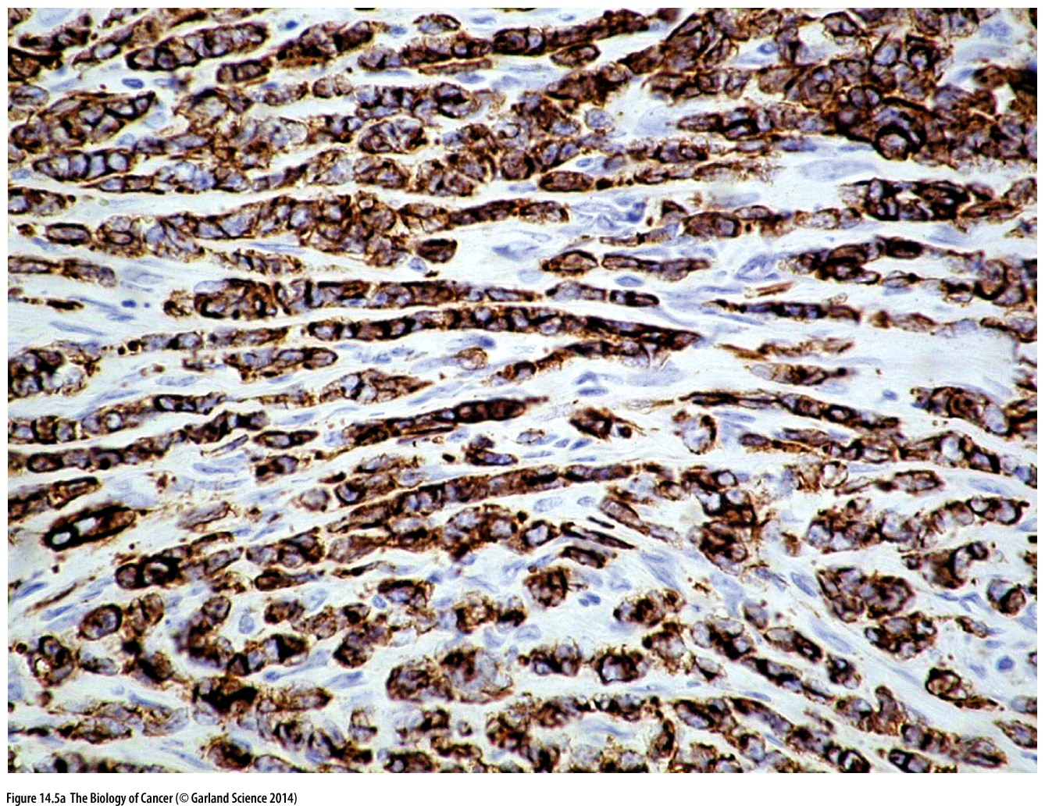
Figure 14.5 Patterns of invasion
(A) These invasive lobular mammary carcinoma cells (brown) have left the primary tumor (not shown to the left) and are proceeding rightward, one-by-one in single file, through channels they have carved in the adjacent stroma (white, gray).

Slide 11
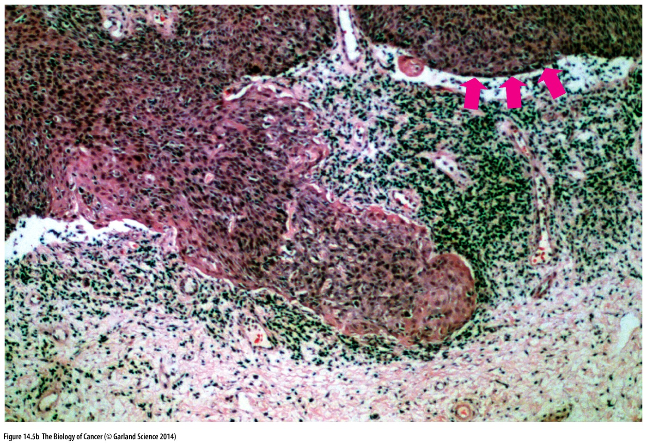
Figure 14.5 Patterns of invasion
(B) Far more typical is the coordinated invasion of a phalanx of carcinoma cells, often termed “collective” invasion. In this squamous cell carcinoma of the cervix, a tongue of many hundreds of cancer cells (pink, brown) has breached the basement membrane and is invading the stroma. The latter is characterized by both fibroblasts and inflammatory cells (dark green). The basement membrane is the dark brown, horizontal line (pink arrows) that separates the bulk of the carcinoma cells (above) from the stromal cells (below) and is uninterrupted except for a capillary and the tongue of invasive cancer cells.

Slide 12
The process of intravasation（渗入血管）is less well studied. Initial studies indicate that in many breast cancers, and possibly in other carcinomas as well, a triad of three distinct cell types—carcinoma cells, macrophages, and endothelial cells—assembles to enable the cancer cells to invade through the endothelial walls into the lumina of capillaries (Figure 14.7).

Slide 13
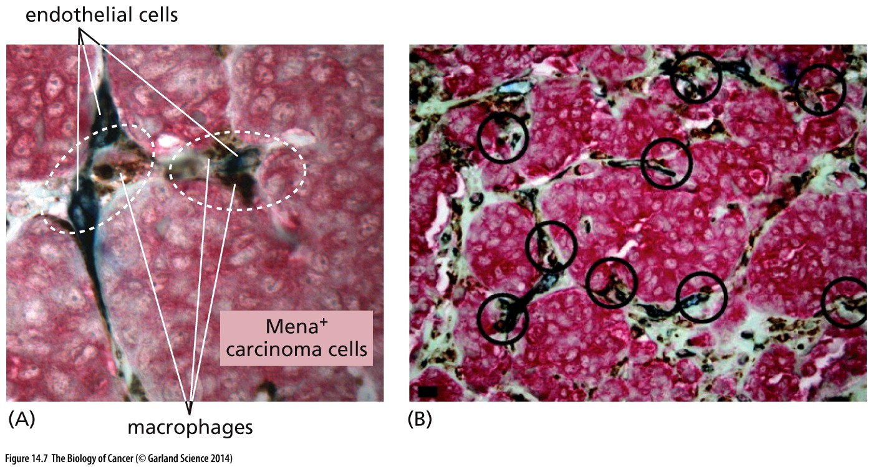
Figure 14.7 Intravasation （渗入血管）
Like local invasion, the process of intravasation by carcinoma cells often—and perhaps always—requires help from stromal cells, in this case macrophages. (A) Detailed investigation of carcinomas, in both laboratory animal models and human tumors, reveals triads (ovals) of carcinoma cells, macrophages, and endothelial cells (sometimes termed TMEM, for tumor microenvironment of metastasis). The macrophages help the carcinoma cells to intravasate through the capillary wall formed by the endothelial cells. A triad is registered only if all three cellular components are directly apposed and if the carcinoma cells express significant levels of the Mena actin-cytoskeleton–regulating protein that is associated with cell motility, seen here as a red stain.
(B) While two human carcinomas may have a very similar histopathological appearance, the counting of the density of TMEM triads (circles) within sections of these tumors generates a highly useful prognostic marker of metastasis.

Slide 14
Nonetheless, we still have an incomplete understanding of the lives of cancer cells in the general circulation, which represents the main route of dissemination leading clinically to metastatic relapse. These circulating tumor cells (CTCs) have been the objects of intensive investigation in recent years.

Slide 15
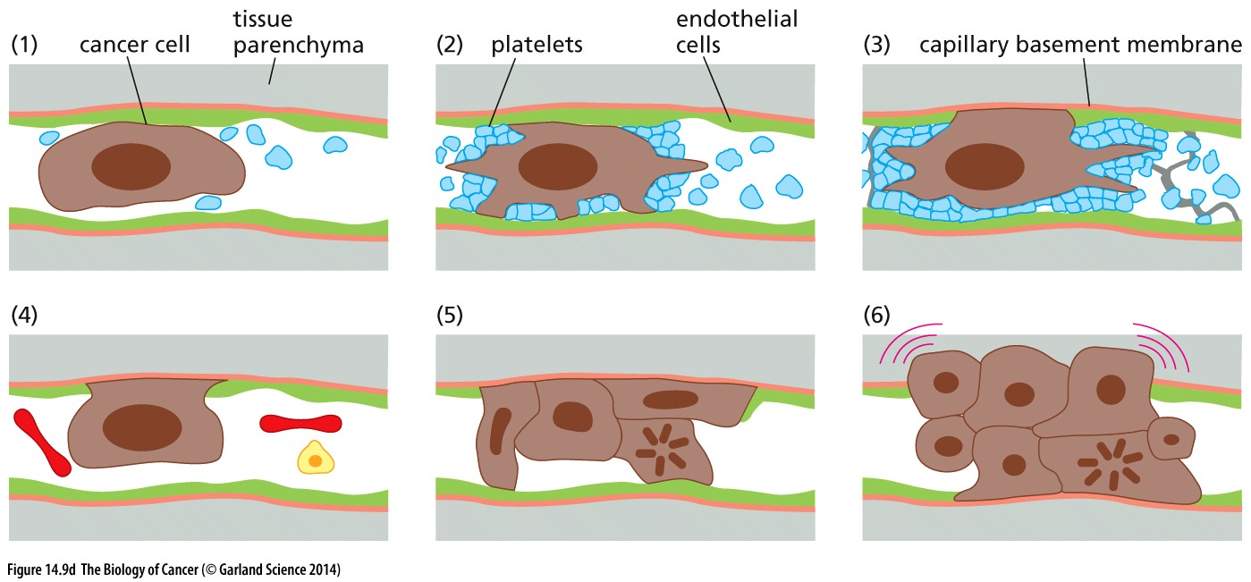
Figure 14.9 Lodging and extravasation（溢出血管） of circulating tumor cells
(D) Electron-microscopic observations of metastasizing lung cancer cells injected into the venous circulation of mice suggest that the process of extravasation often proceeds via an alternative sequence of steps, as indicated here. (1) A metastasizing cell (brown) is trapped physically in a capillary. (2) Within minutes, a large number of platelets (blue) become attached to the cancer cell, forming a microthrombus（微小血栓）. (3) The cancer cell pushes aside an endothelial cell (green) on one wall of the capillary, thereby achieving direct contact with the underlying capillary basement membrane (orange). (4) Within a day, the microthrombus is dissolved by the proteases that are responsible for dissolving clots. (5) The cancer cell begins to proliferate in the lumen of the capillary. (6) Within several days, sometimes sooner, the cancer cells break through the capillary basement membrane and invade the surrounding tissue parenchyma (gray area).

Slide 16
14.2 Colonization represents the most complex and challenging step of the invasion–metastasis cascade

Slide 17
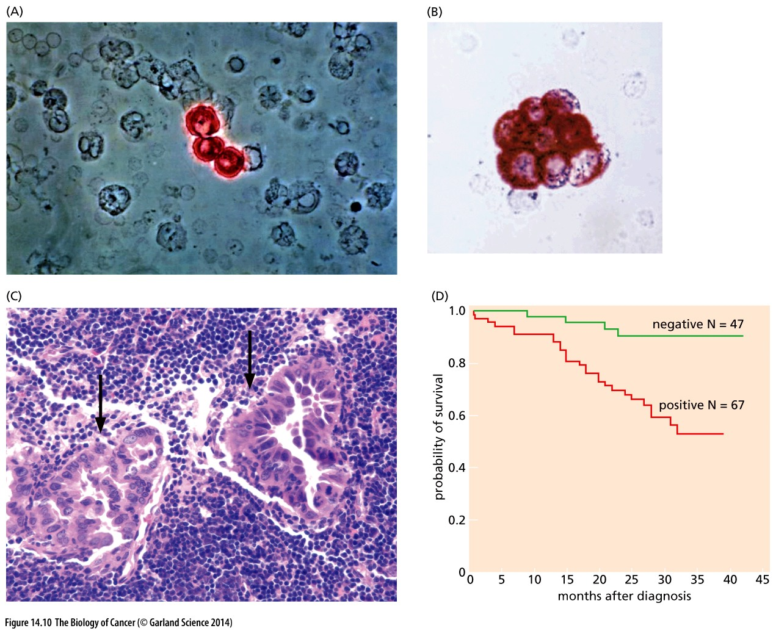
Figure 14.10 Detection of micrometastases（微小转移） in the marrow or lymph node
by staining with an anticytokeratin antibody (red). This staining is highly specific, since normal marrow cells are of mesenchymal/hematopoietic origin and thus do not express cytokeratins. In contrast, epithelial cells, and (usually) their neoplastic descendants, express cytokeratins at significant levels.
Cytokeratin-positive cells in the marrows of a cohort of breast cancer patients were counted
Cytokeratin----- epithelial

Slide 18
14.3 The epithelial–mesenchymal transition and associated loss of E-cadherin expression enable carcinoma cells to become invasive
Notes:
上次课提到Wounding healing and EMT

Slide 19
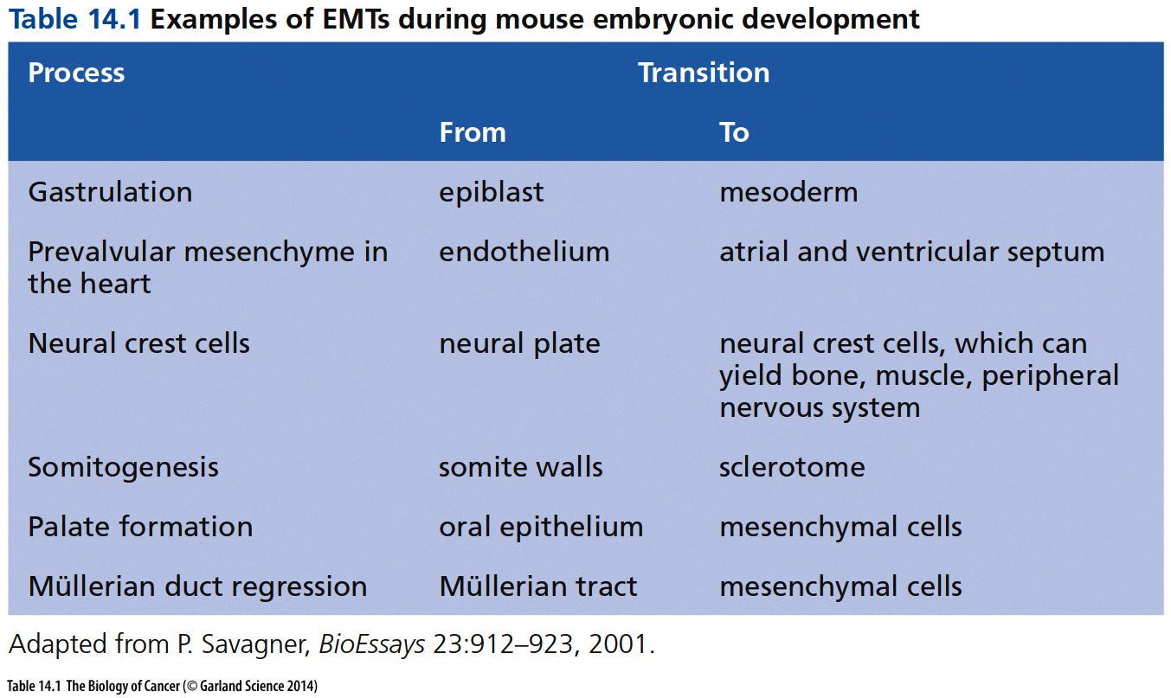
原肠胚形成
前瓣膜
上颚

Slide 20
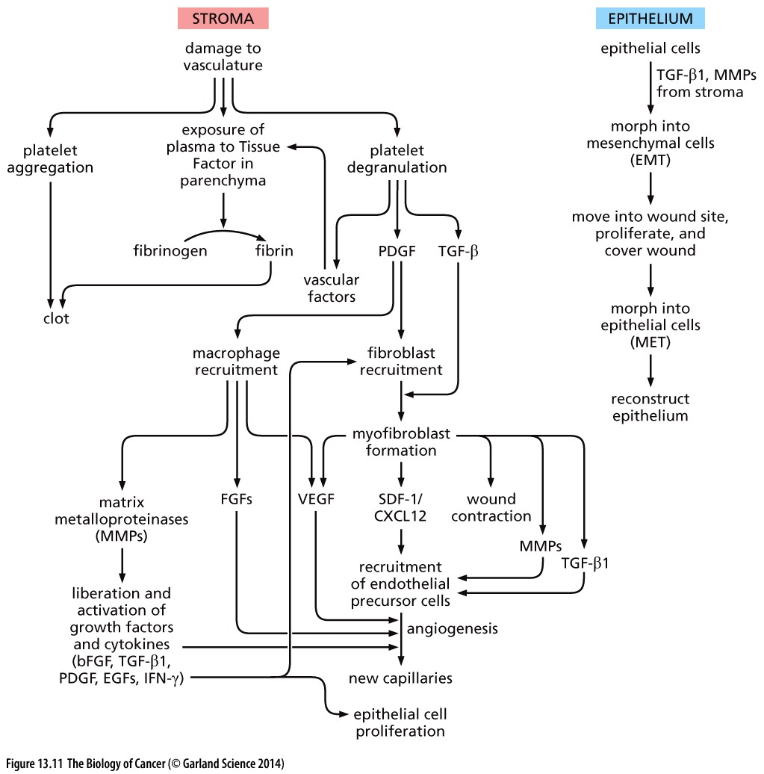
EMT and wound healing

Slide 21
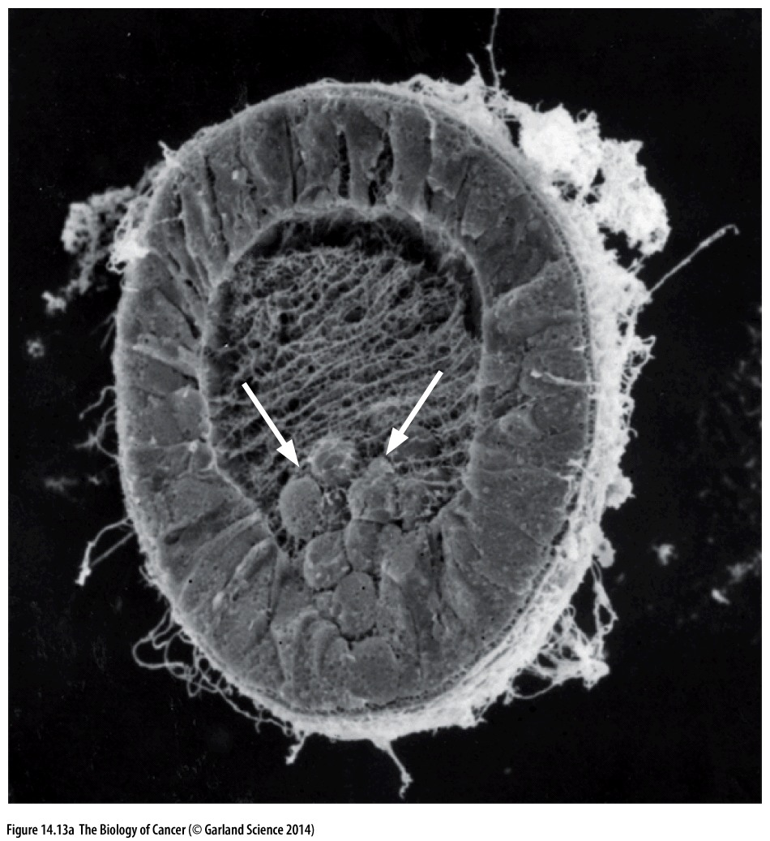
Figure 14.13 Embryogenesis and the epithelial–mesenchymal transition
(A) This scanning electron micrograph shows the delamination（分层） of cells from the primitive ectoderm of a sea urchin embryo (white arrows) and their migration into the interior of the embryo— the process of gastrulation（原肠胚形成）. These cells have become round and acquired motility in anticipation of forming the rudiments of the mesoderm—changes associated with an epithelial–mesenchymal transition (EMT). They are migrating along strands of extracellular matrix in the blastocoel（囊胚腔）of this early embryo.

Slide 22
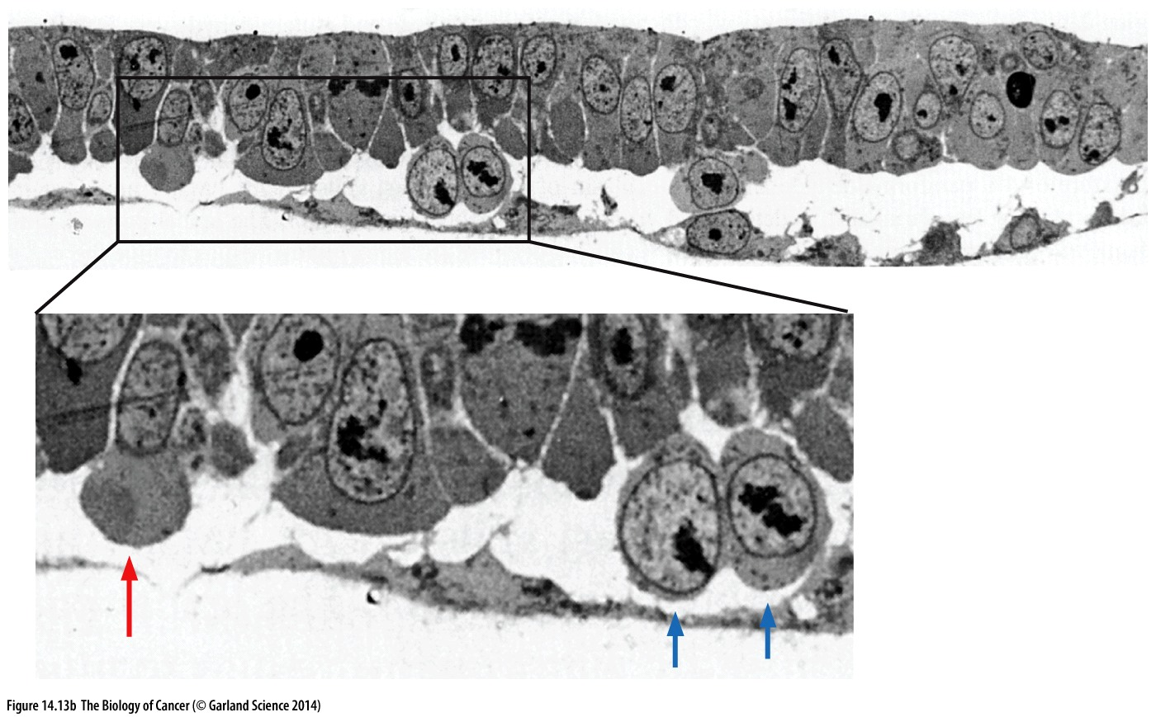
(B) The process of gastrulation in mammals, such as in the early rabbit embryo studied here, is superficially quite different but depends on very similar processes. As revealed by this transmission electron micrograph, one cell of the primitive ectoderm (also termed epiblast; red arrow) is in the midst of undergoing an EMT, while two other cells (blue arrows) have already delaminated from the epiblast and become mesenchymal, thereby initiating the formation of mesodermal tissues.

Slide 23
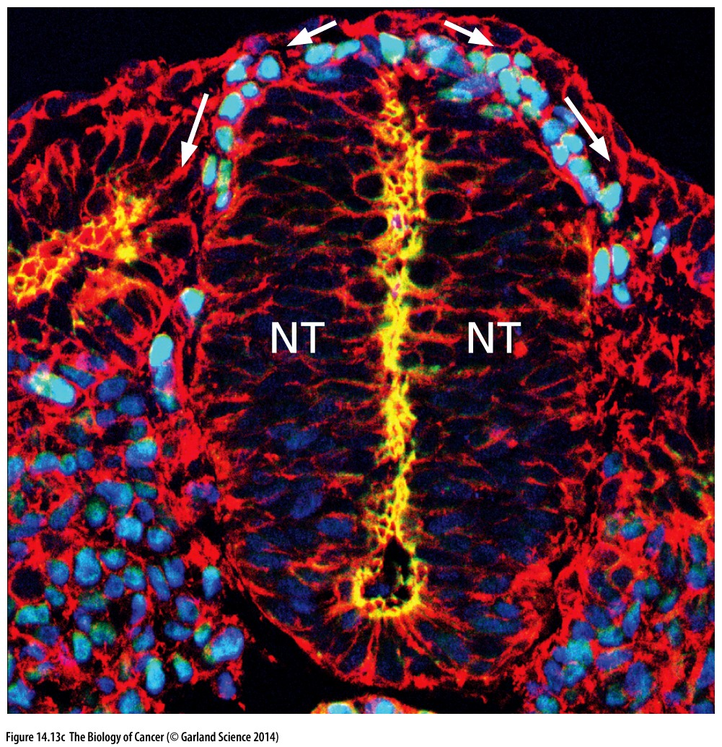
(C) Certain cells derive from the upper region of the neural tube (NT, center) and can be immunostained for the Sox 9 transcription factor. These cells (light blue, top) arise in the embryonic neural crest of chordates and undergo an EMT, delaminate from this epithelium, acquire motility and invasiveness, and disperse (arrows) throughout the embryo, where they form melanocytes, much of the peripheral nervous systems, and much of the skeleton of the face. The neural epithelium is immunostained for N-cadherin (yellow). All cells are stained with phalloidin to reveal their actin cytoskeleton (red) and with DAPI to indicate their nuclei (dark blue).

Slide 24
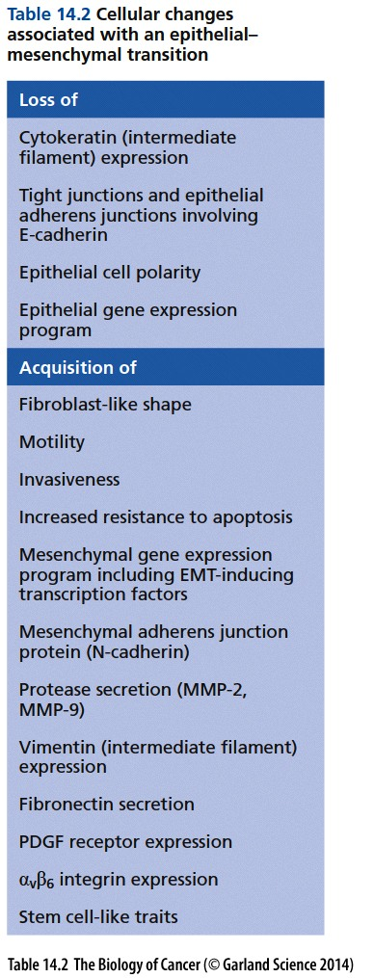
An EMT can also be seen at the edges of carcinomas that are invading adjacent tissues (Figure 14.14). This pathological process is very similar to the EMTs occurring during early embryogenesis and wound healing. It is plausible, though hardly proven, that all types of carcinoma cells must pass, at least partially, through an EMT in order to become motile and invasive.

Slide 25
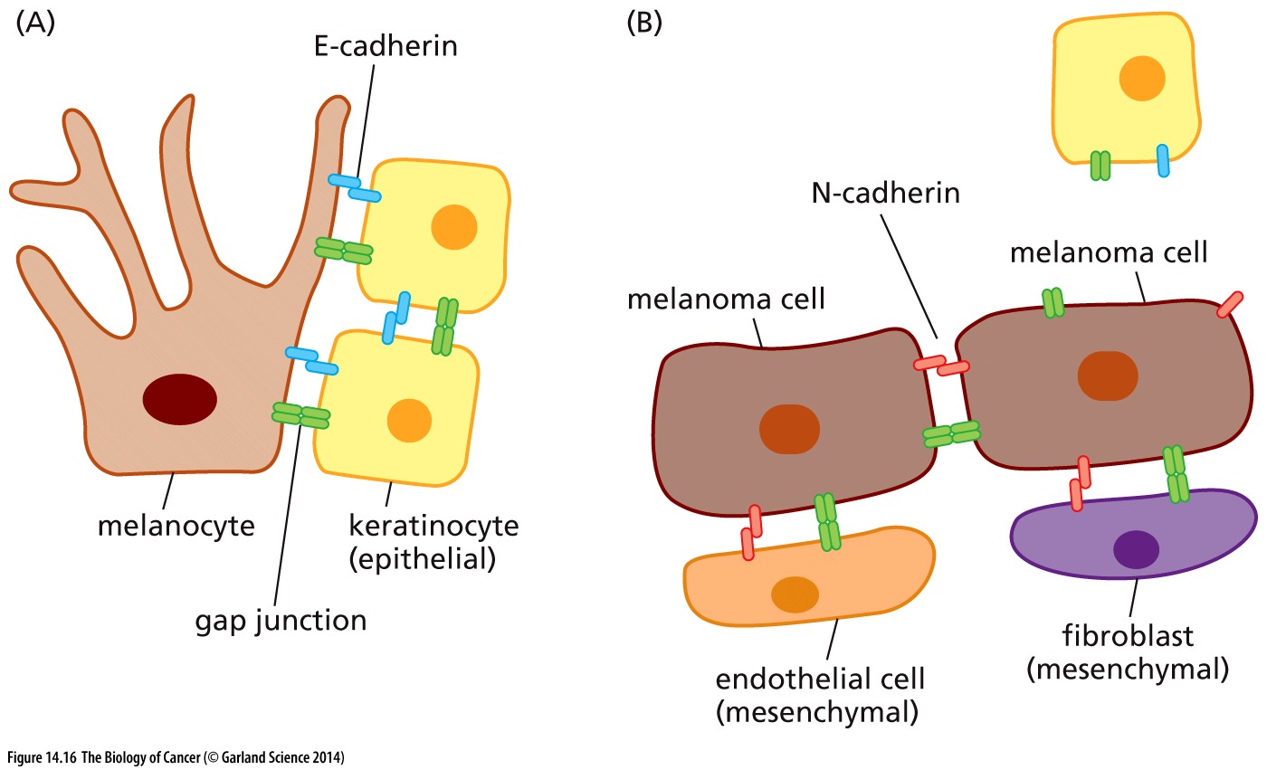
Figure 14.16 Cadherin shifts and melanoma cell invasiveness
Melanomas are among the most malignant tumors because of their tendency to metastasize widely once they reach a certain stage of tumor progression. This behavior is attributable, in part, to the reactivation of a cell biological program that enabled the migratory behavior of their neural crest ancestors (see Figure 14.13C). The shift from E- to N-cadherin expression, which occurs when melanocytes (A) become transformed into melanoma cells (B), has been proposed to facilitate invasion of the stroma, since the shutdown of E-cadherin expression (blue) enables these cancer cells to extricate(脱身) themselves from their keratinocyte neighbors in the epidermis, while its replacement by expression of N-cadherin (reddish pink) allows these tumor cells to form homotypic interactions with various types of mesenchymal cells, such as fibroblasts and endothelial cells.

Slide 26
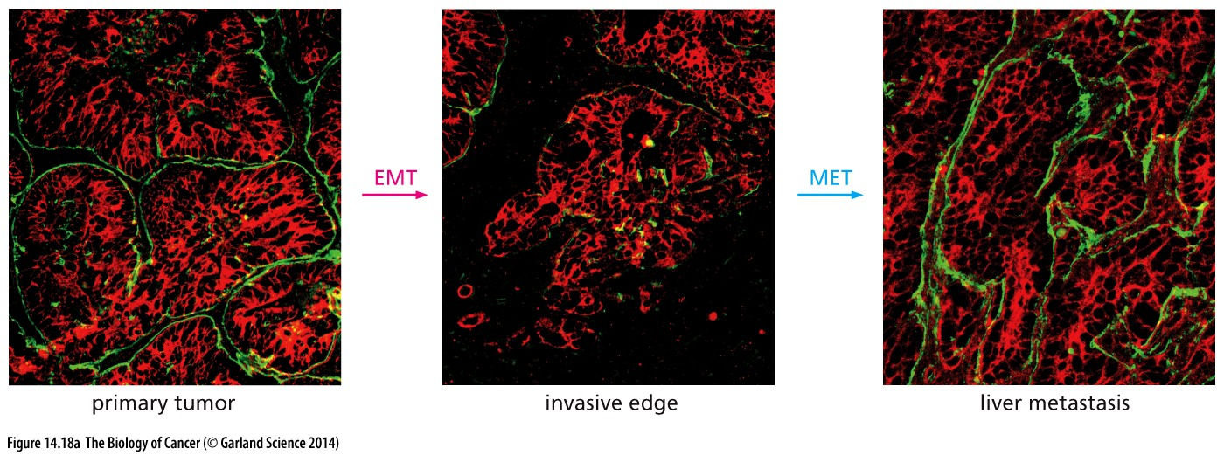
Reversibility of EMT
the metastases deriving from a primary tumor often bear striking resemblance at the histopathological level to this tumor (Figure 14.18A and B). Hence, if the founders of these metastases underwent an EMT during initial dissemination (which would have striking effects on their histopathological appearance), these EMT-associated changes must have been lost during the formation of the metastasis.

Slide 27
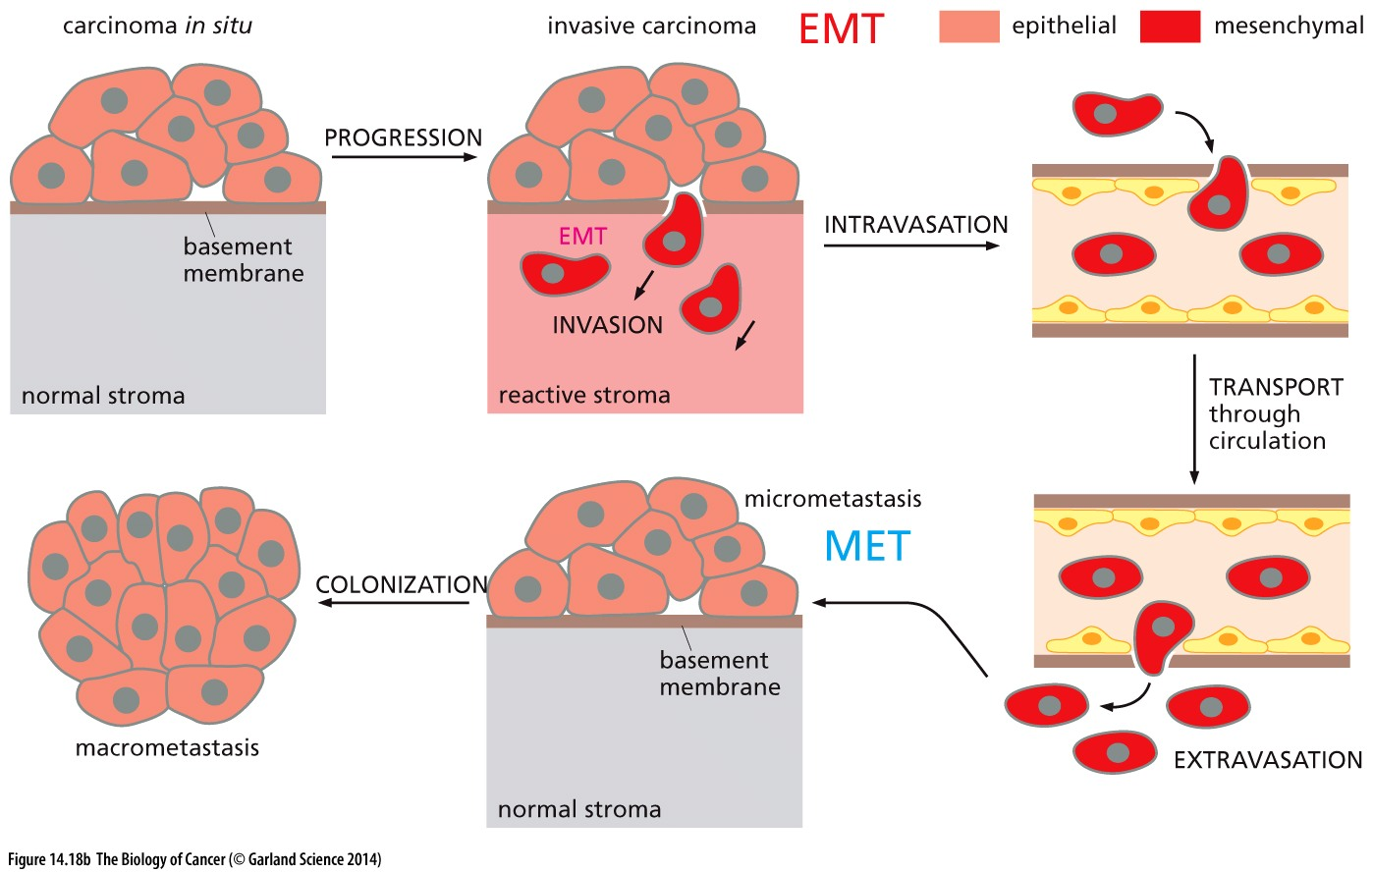
Reversibility of EMT

Slide 28
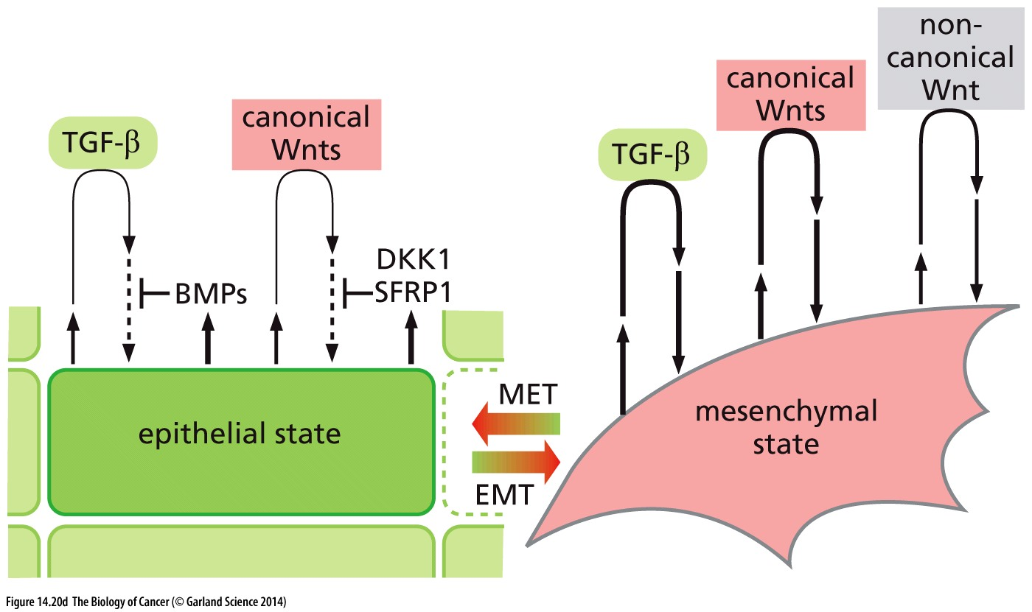
Figure 14.20 Multiple signals collaborate to induce and then maintain the mesenchymal state
Notes:
细节仅供参考

Slide 29
14.5 Stromal cells contribute to the induction of invasiveness

Slide 30
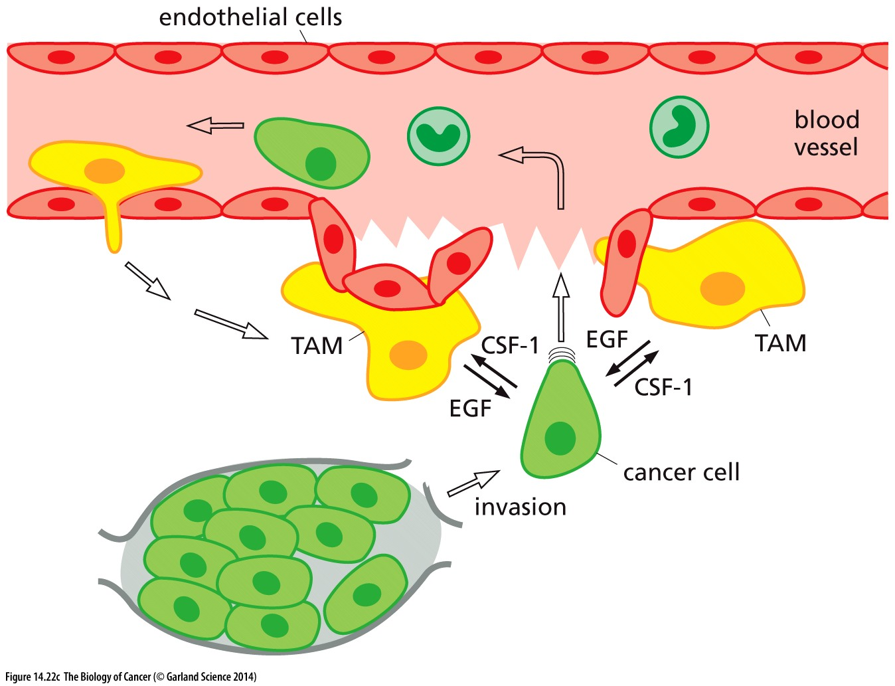
Figure 14.22 Reciprocal stimulation by breast cancer cells and macrophages
(C) The reciprocal interactions between breast cancer cells and macrophages are illustrated schematically here. Because macrophages are often found in close proximity to microvessels, the stimulation by tumor-associated macrophages (TAMs) of breast cancer cell motility and invasiveness may also contribute to cancer cell intravasation, as suggested by the observations of Figure 14.7 and depicted here in more mechanistic detail.

Slide 31
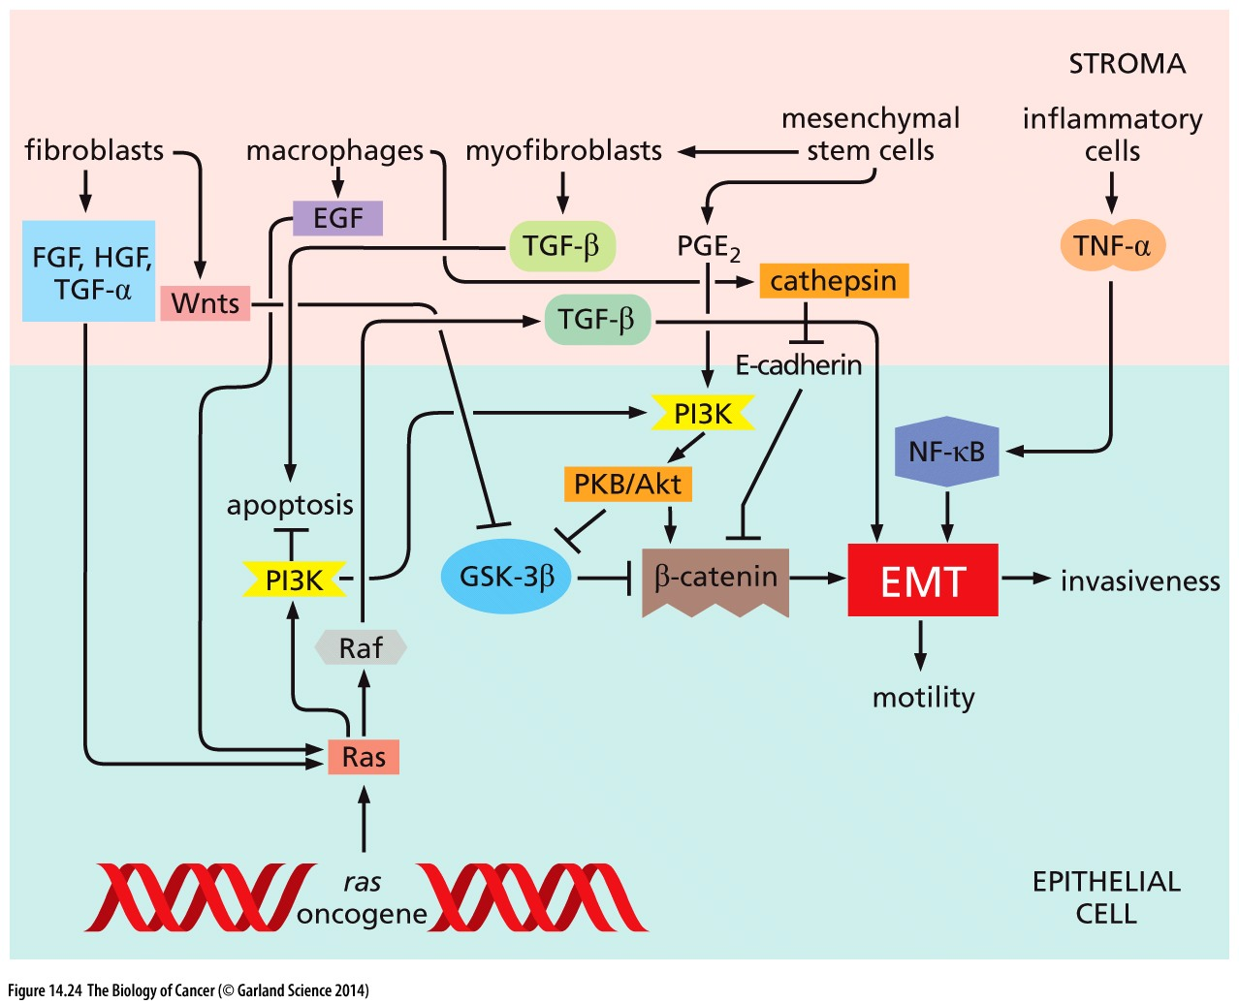
Figure 14.24 Signals that trigger an EMT
This diagram presents a highly simplified view of the signaling channels that originate in the stroma and influence epithelial cancer cells to undergo a partial or complete EMT. It is likely that an EMT program is usually triggered in response to a confluence of signals that carcinoma cells receive from the stroma together with intracellular signals, such as those released by a ras oncogene, as indicated here. The precise identities of these stromal signals and their combinatorial mechanisms of action remain to be elucidated.

Slide 32
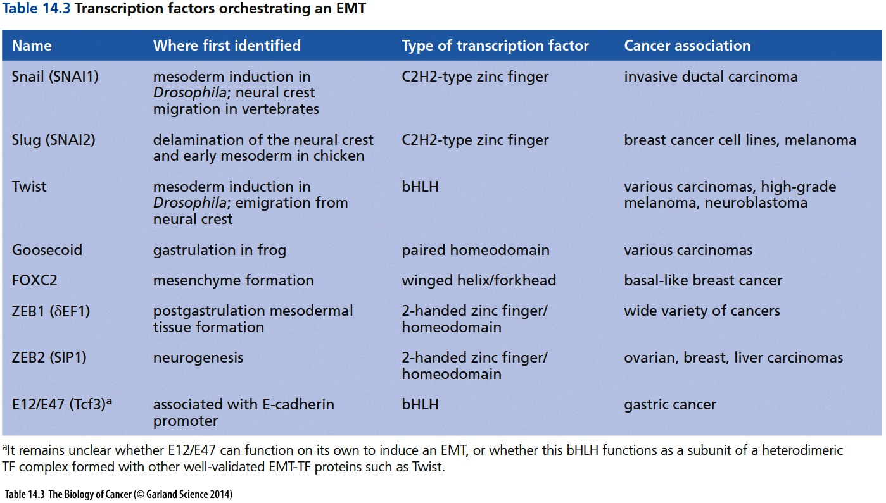

Slide 33
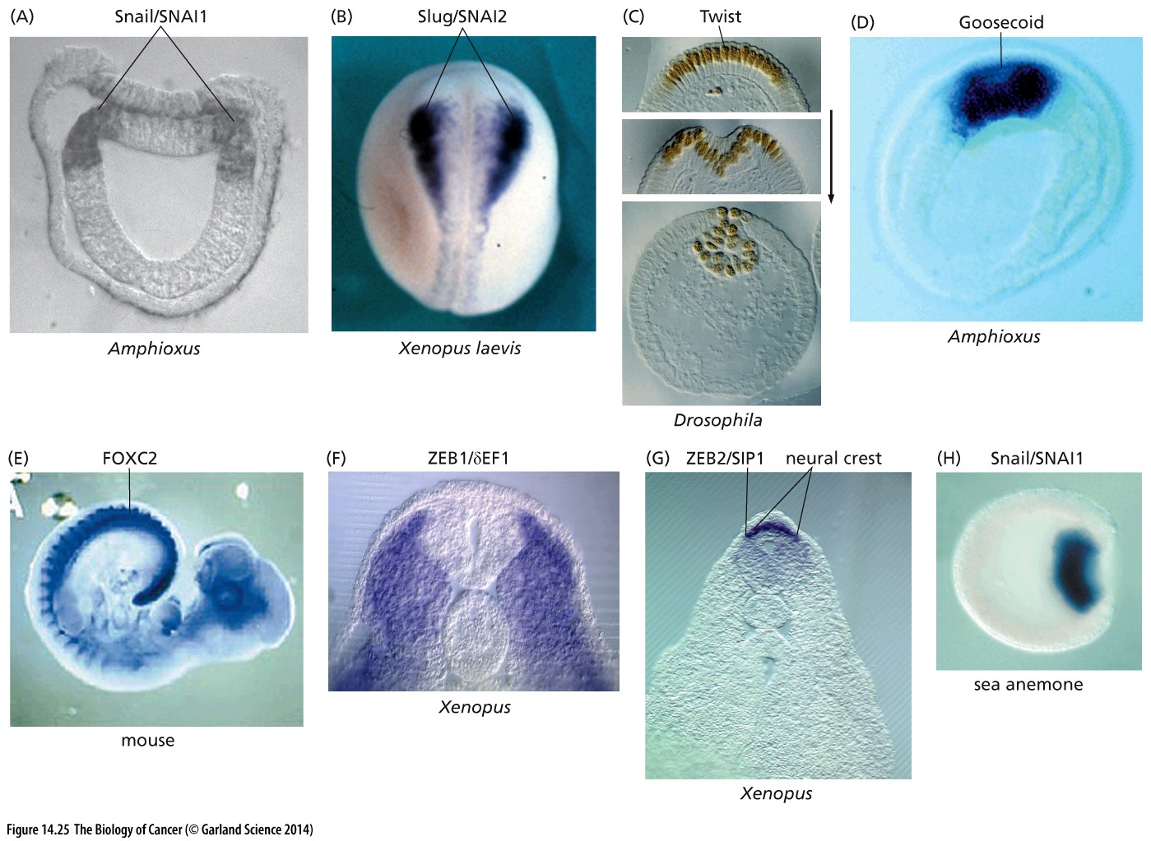
Figure 14.25 Embryonic transcription factors programming epithelial–mesenchymal transitions

Slide 34
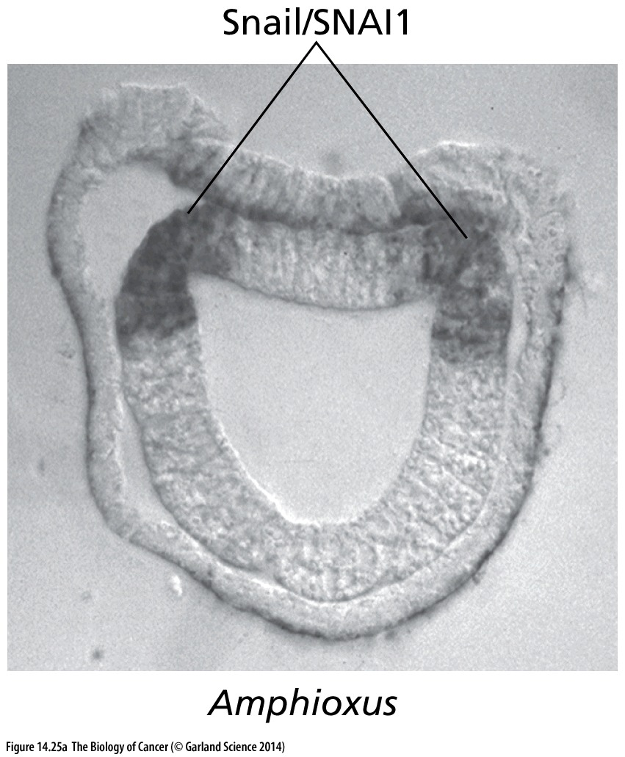

Slide 35
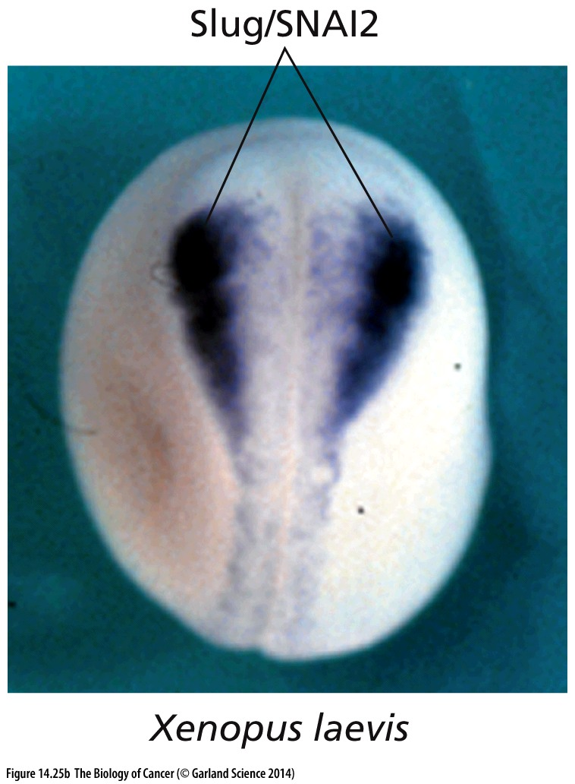

Slide 36
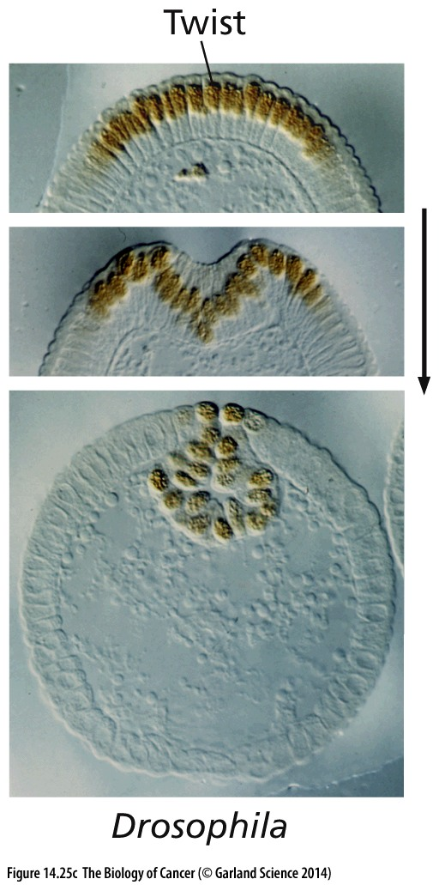
(C) Twist is shown here in an early Drosophila embryo,
in which it programs an EMT at the site of gastrulation (brown).

Slide 37
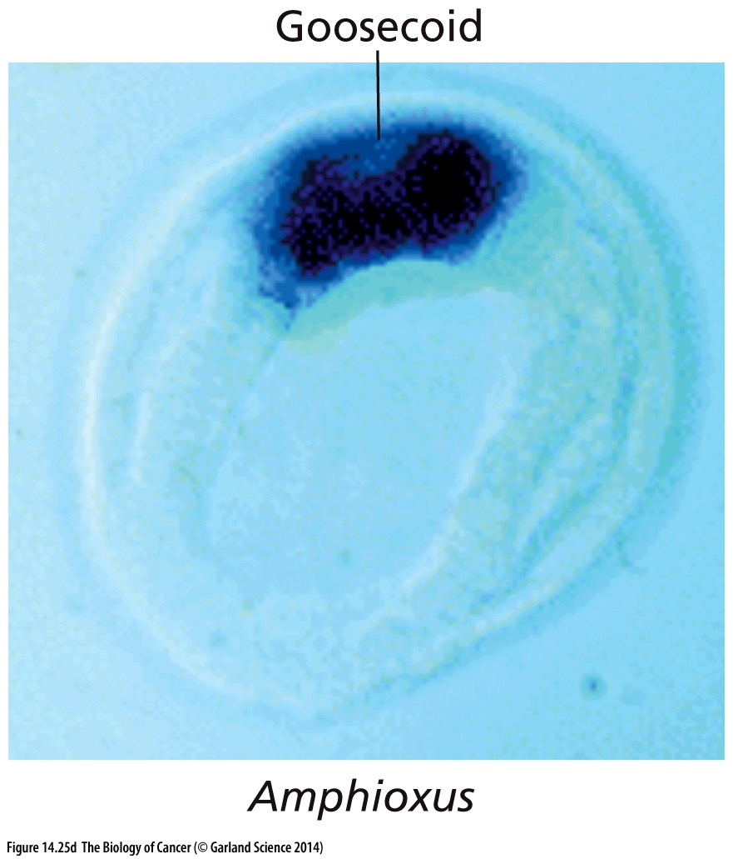

Slide 38
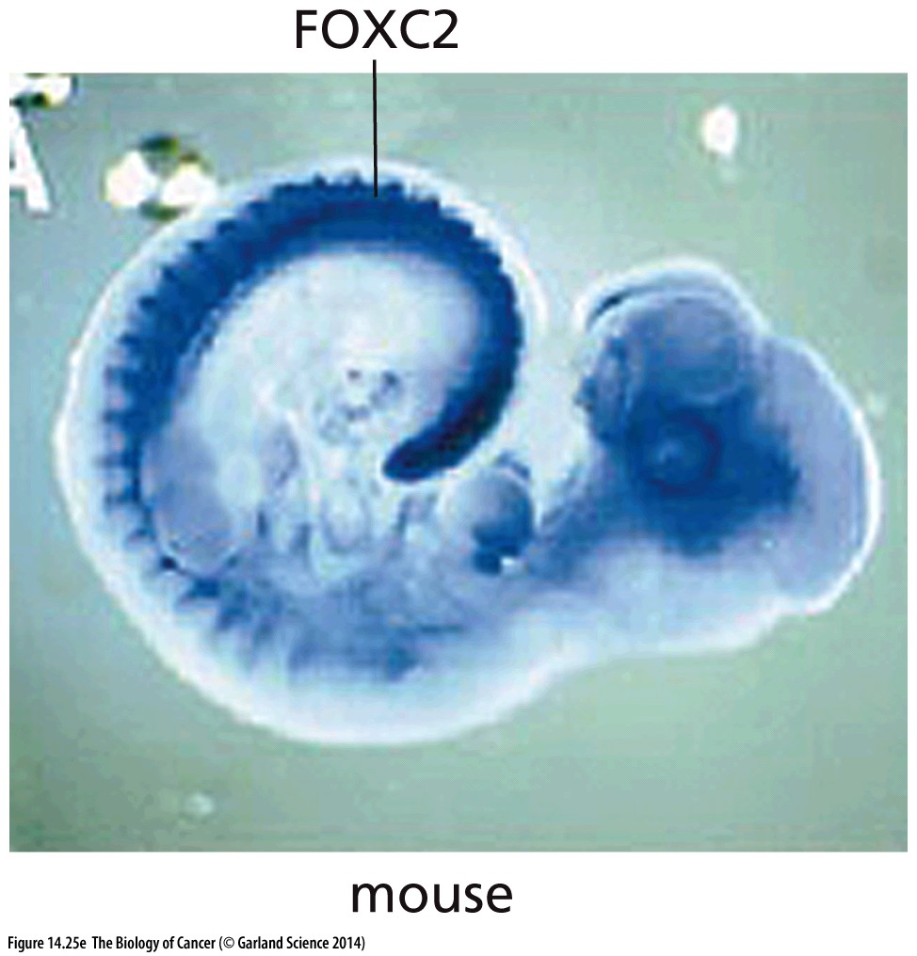

Slide 39
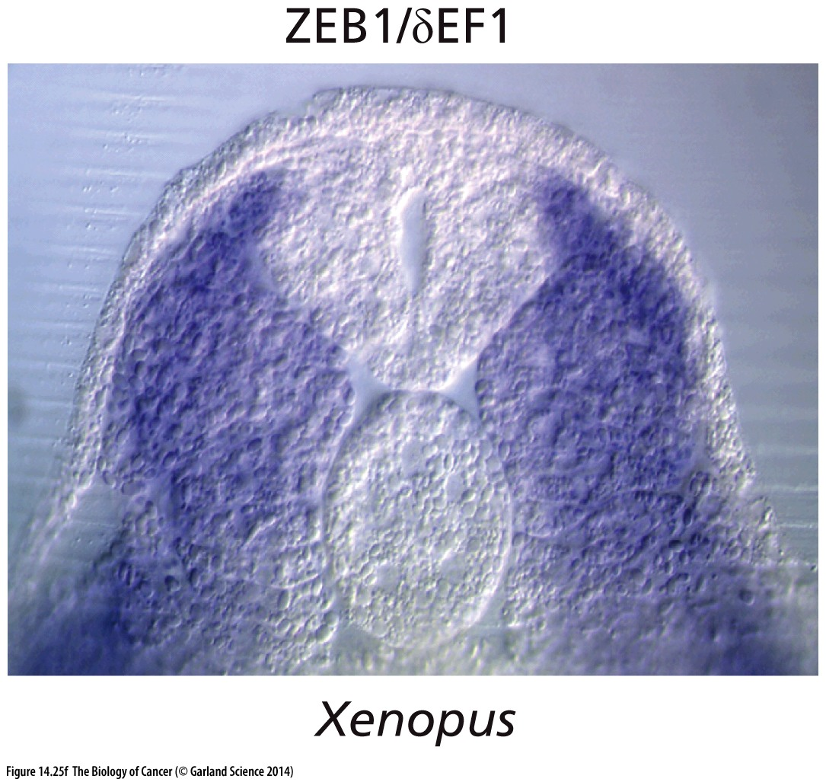

Slide 40
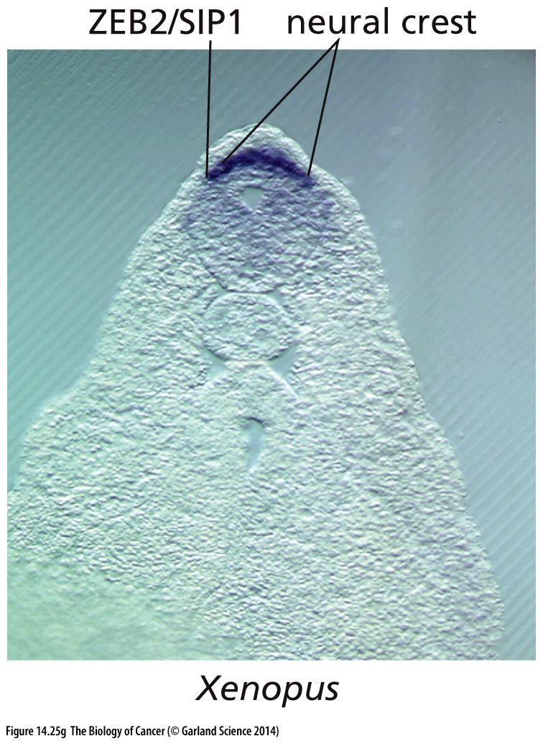

Slide 41
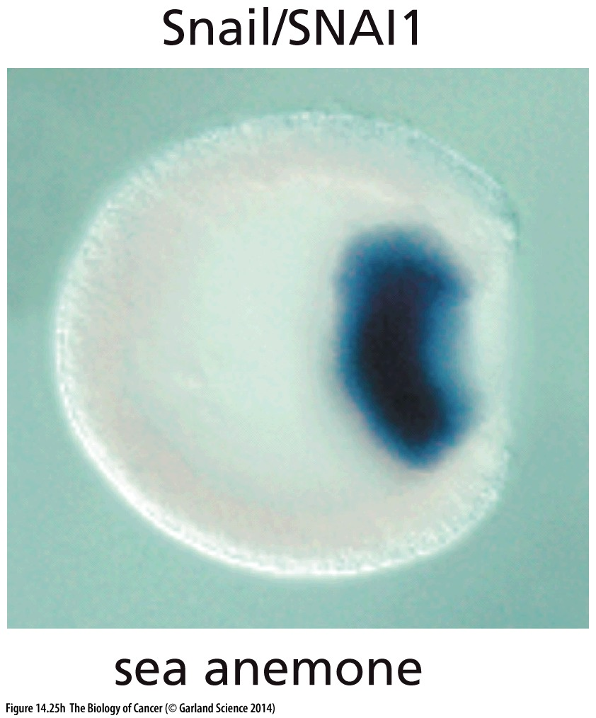

Slide 42
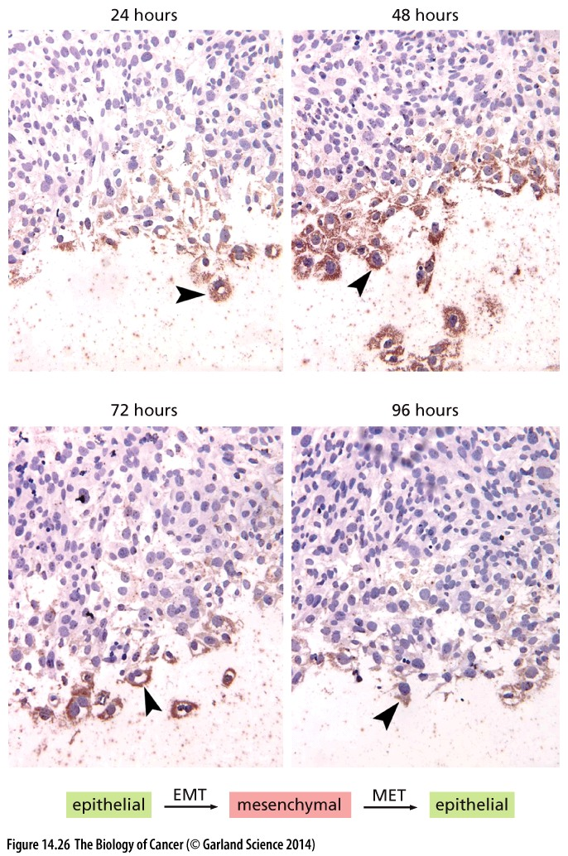
Figure 14.26 Transient expression of an EMT-inducing transcription factor in wound healing
Expression of the Slug transcription factor is induced transiently in a monolayer culture of keratinocytes that has been wounded by scraping away a swath of cells.

Slide 43
14.7 EMT-inducing transcription factors also enable entrance into the stem cell state
The cellular traits that are induced by the actions of one or another EMT-TF suggest that these master regulators can orchestrate almost all of the steps of the invasion–metastasis cascade. There is, however, one trait that is critical for metastasis that has not yet been considered here: in order for a disseminated cancer cell to seed a metastasis, it must possess the tumor-initiating ability that we previously ascribed to cancer stem cells (CSCs; see Section 11.6).

Slide 44
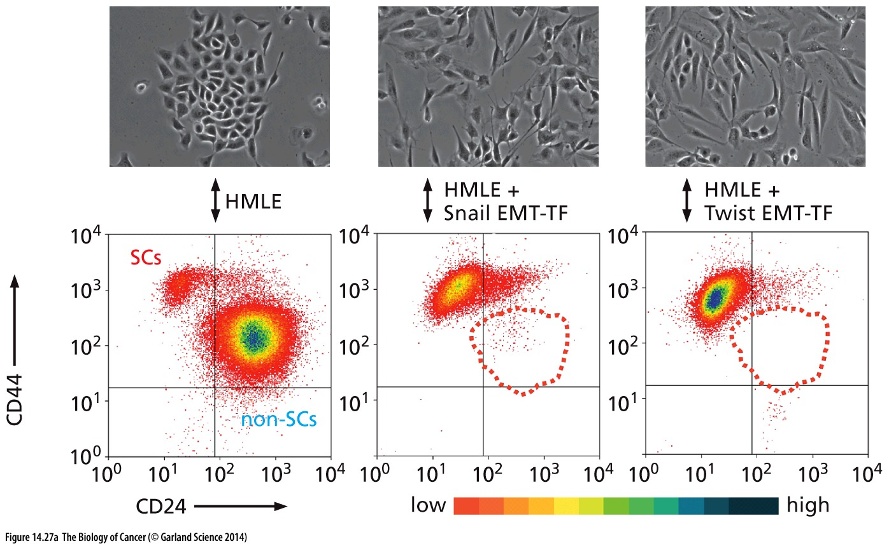
Figure 14.27 EMT-inducing transcription factors confer stem cell properties on epithelial cells
fluorescence-activated cell sorting (FACS)
into a minority subpopulation that has a CD44hi CD24lo cell surface profile
experimentally immortalized human
mammary epithelial cells, termed HMLE

Slide 45
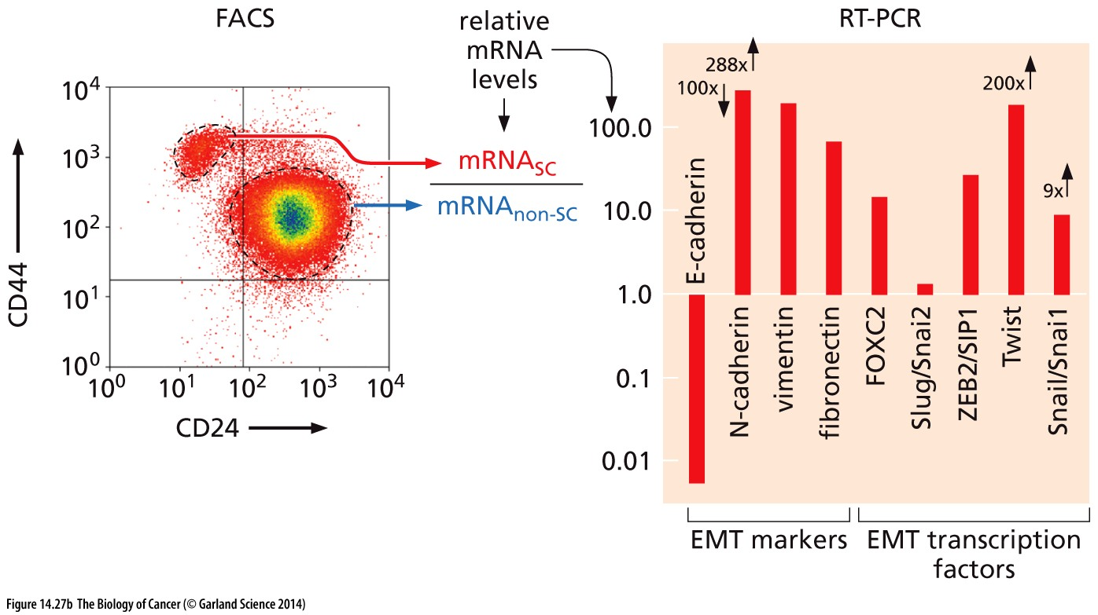
Figure 14.27 EMT-inducing transcription factors confer stem cell properties on epithelial cells

Slide 46
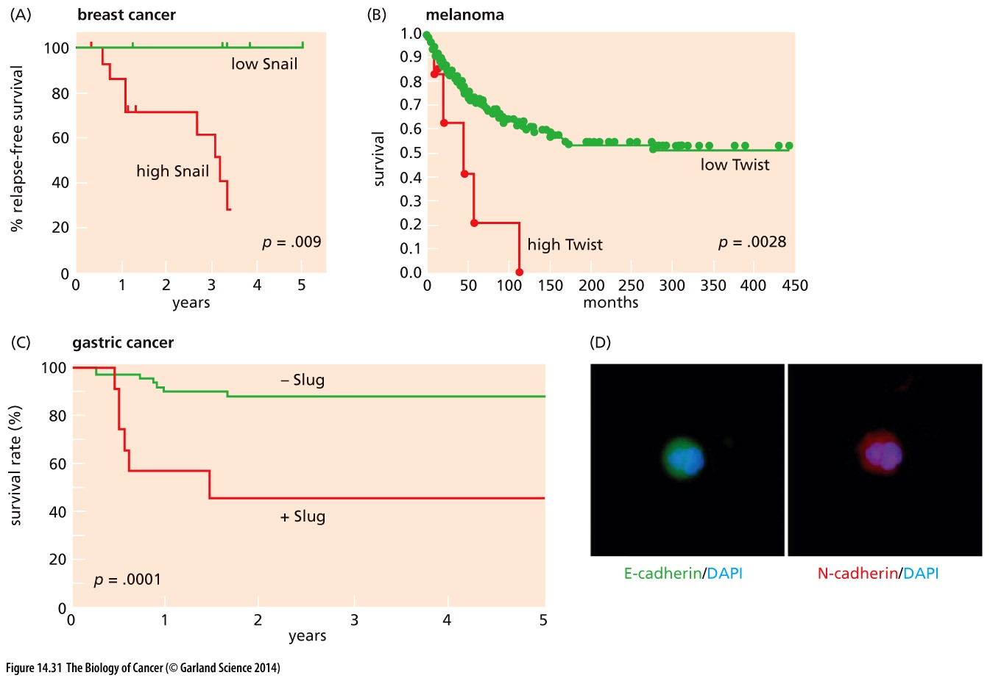
Figure 14.31 Indications of the role of EMT-inducing transcription factors in human tumor progression
Circulating tumor cells (CTCs)
Notes:
This co-expression of epithelial and mesenchymal proteins within a single cell would appear to serve as a fingerprint of its origin in a primary tumor in
which it or its immediate precursors underwent a partial EMT under the direction of an unknown EMT-TF or set of EMT-TFs.

Slide 47
14.9 Extracellular proteases play key roles in invasiveness
the most obvious trait of malignant cells—their ability to invade
adjacent cell layers.
The most important effectors of these complex changes are the matrix metalloproteinases (MMPs; see Table 13.1). In carcinomas, the bulk of these proteases are secreted by recruited stromal cells, notably macrophages, mast cells, and fibroblasts, rather than by the neoplastic epithelial cells (Figure 14.32).

Slide 48
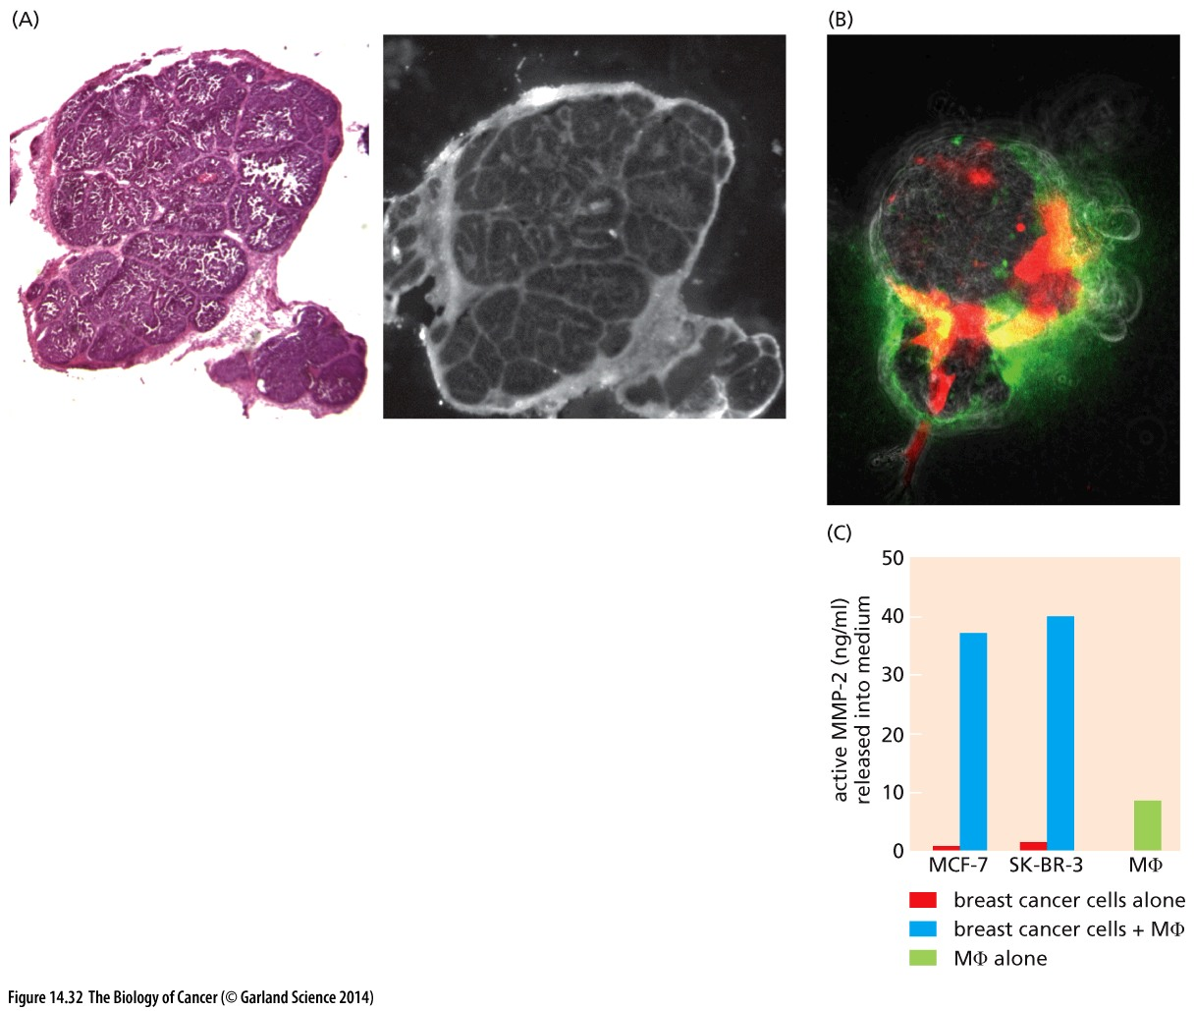
Figure 14.32 Matrix metalloproteinases produced by tumor-associated cells
MMPs are produced largely by inflammatory cells and fibroblasts in the tumor stroma.

Slide 49
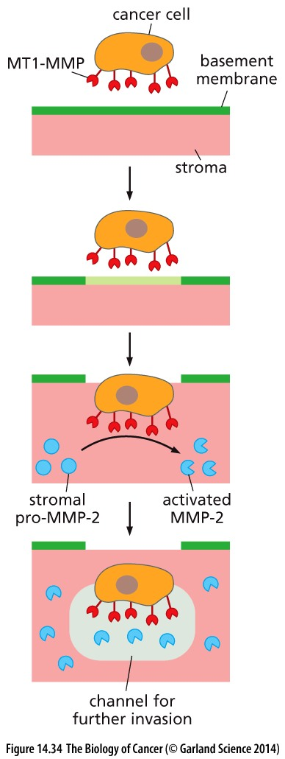
Figure 14.34 Collaboration of MT1-MMP and MMP-2 in carcinoma cell invasion
Membrane-tethered proteases, notably MT1-MMP, initially enable carcinoma cells to degrade the basement membrane (green) that separates them from the adjacent stroma. Once in direct contact with the stroma (pink), MT1-MMP can cleave pro-MMP-2 made by the stromal cells, converting it to an active, soluble protease. MT1-MMP also partially cleaves collagen I, which normally forms a densely interwoven network in the ECM of the stroma (see Figure 14.33B); the activated MMP-2 then proceeds to degrade the initially formed collagen I cleavage products to lower–molecular-weight fragments. Dissolving the collagen I network creates a channel immediately in front of the carcinoma cell that allows it to invade more deeply into the stroma.

Slide 50
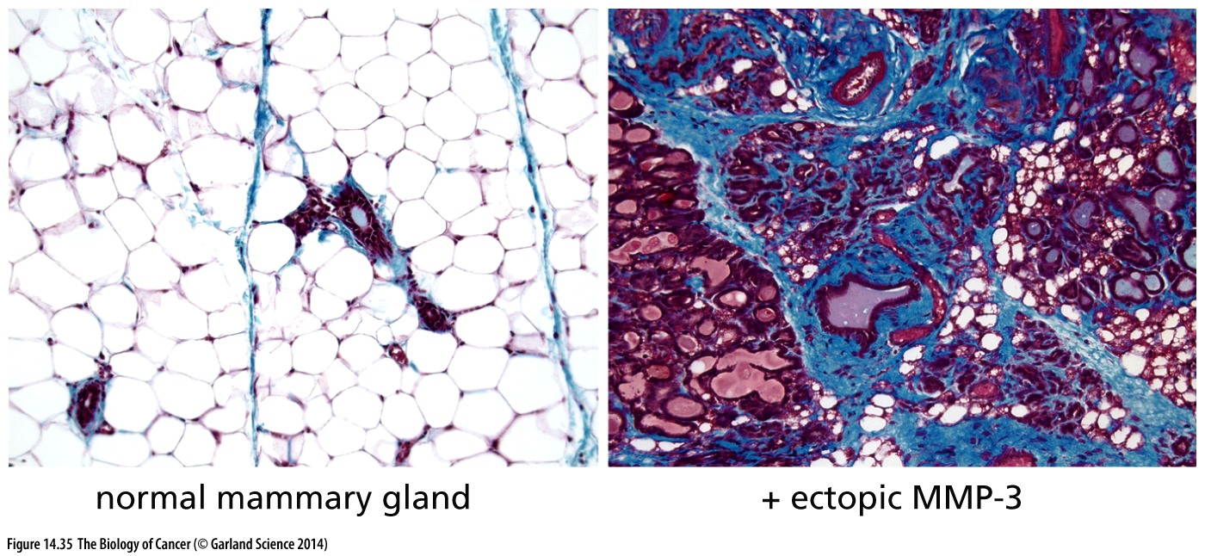
Figure 14.35 Ectopic expression of MMP-3 and mammary tumor progression
when the gene encoding MMP-3 (also known as stromelysin-1) is expressed constitutively as a transgene in the mammary epithelium, the mice develop abundant hyperplasia (right panel), including extensive islands of hyperplastic epithelial cells (purple) that form ducts, as well as a fibrotic, collagen-rich stroma (light blue) and abnormal adipocytes (white oval structures, lower right

Slide 51
14.10 Small Ras-like GTPases control cellular processes such as adhesion, cell shape, and cell motility

Slide 52
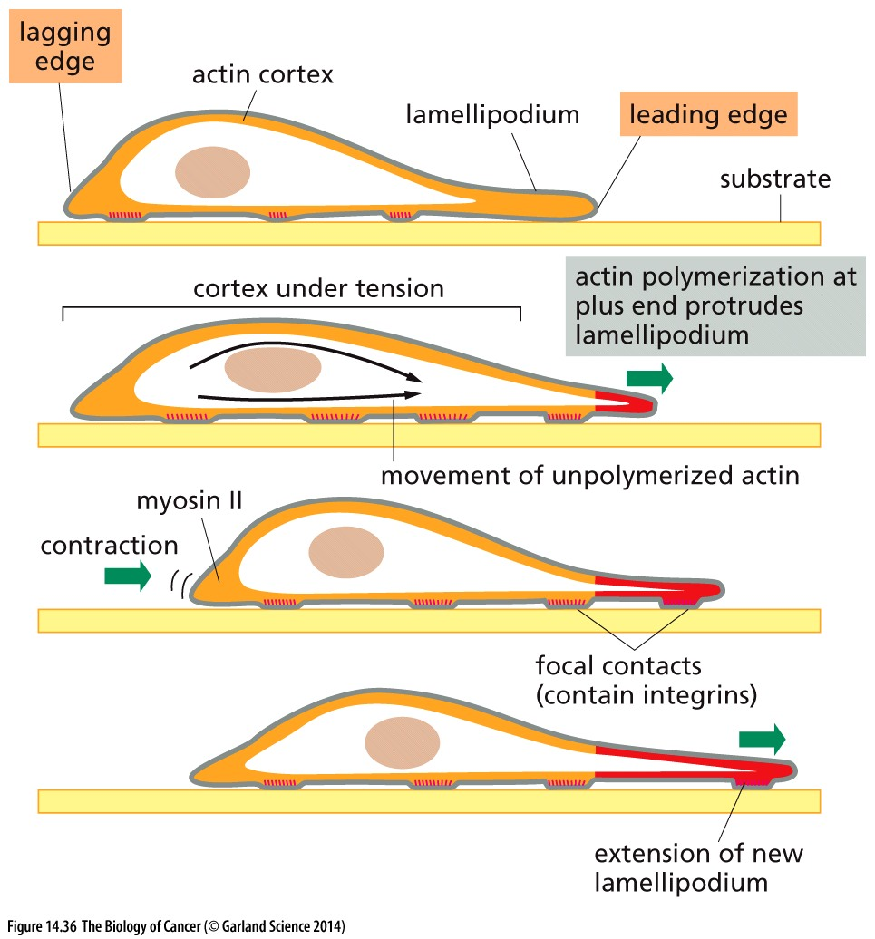
Figure 14.36 Locomotion of cells on solid substrates

Slide 53
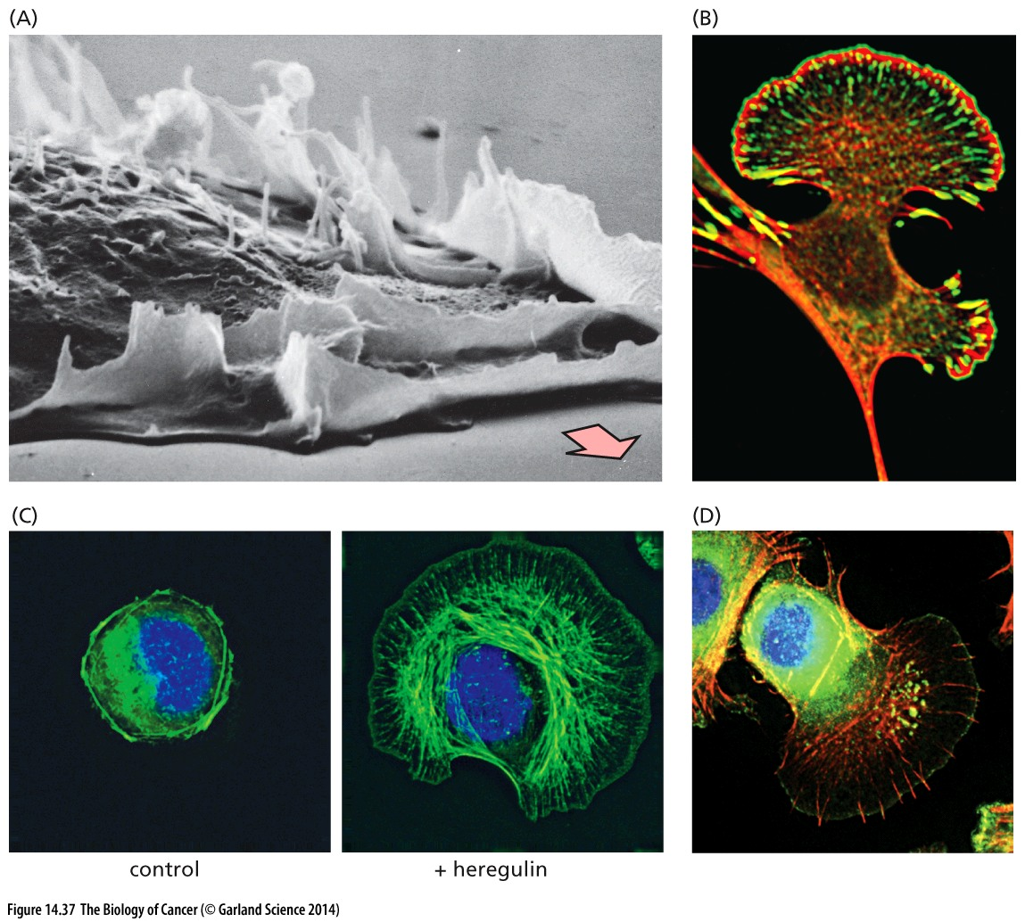
Figure 14.37 Lamellipodia（板状伪足）and filopodia（丝状伪足）
actin fibers ：phalloidin (red), Ena/VASP family, which programs the advance of the lamellipodium by organizing its focal adhesions and its outer edge,is labeled here with green fluorescent protein (GFP),
Scanning electron micrograph —lamellipodia
Filopodia protrude from the leading edges of cells, often from the edges of lamellipodia
actin fibers(Greeen)
actin fibers(Red)

Slide 54
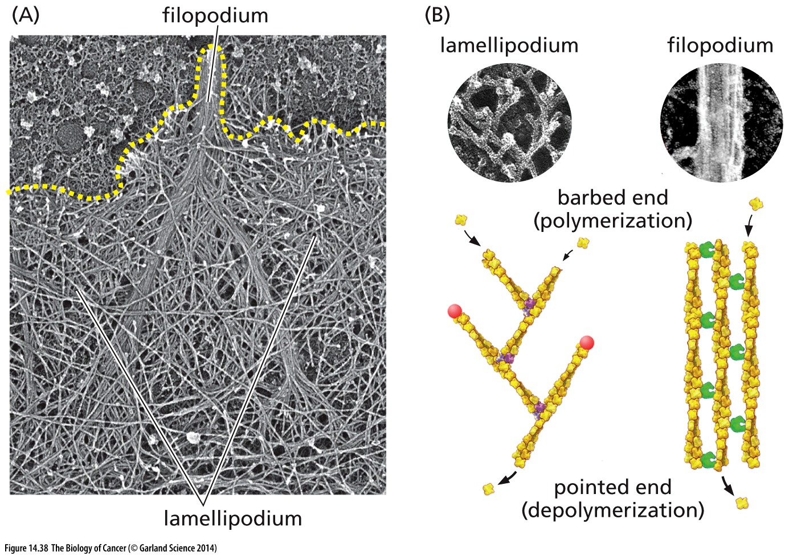
Figure 14.38 The actin cytoskeleton and the restructuring of the cell surface
Both lamellipodia and filopodia depend on the formation of specific configurations of the actin cytoskeleton that lies immediately beneath the plasma membrane.

Slide 55
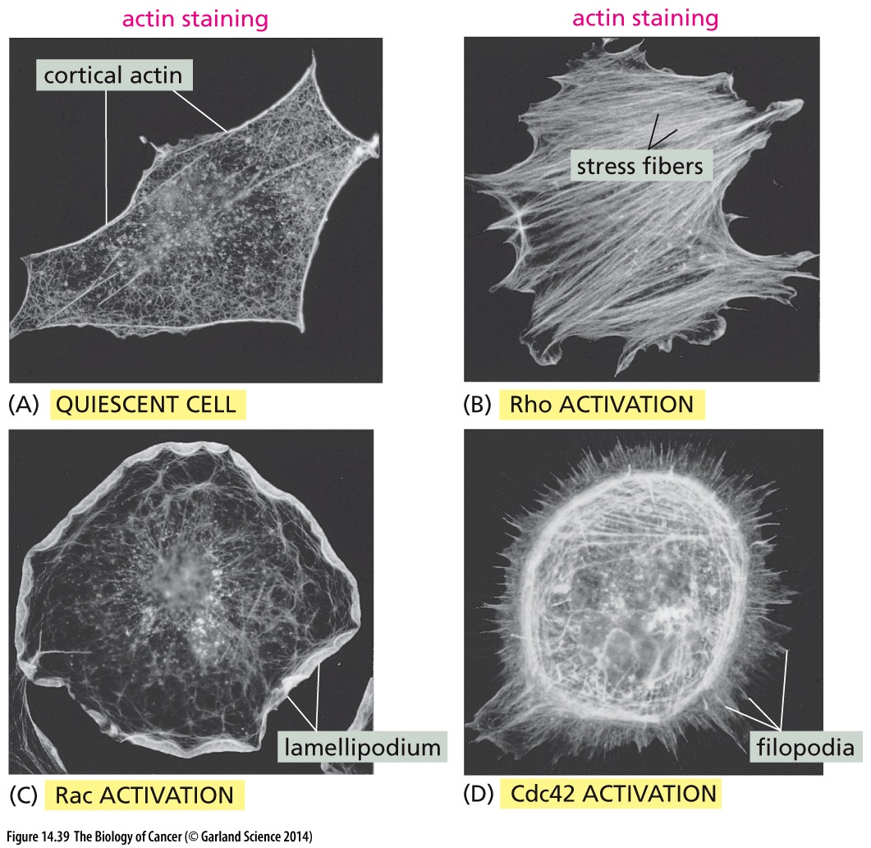
Figure 14.39 Effects of Rho-like proteins on the actin cytoskeleton and cell adhesion

Slide 56
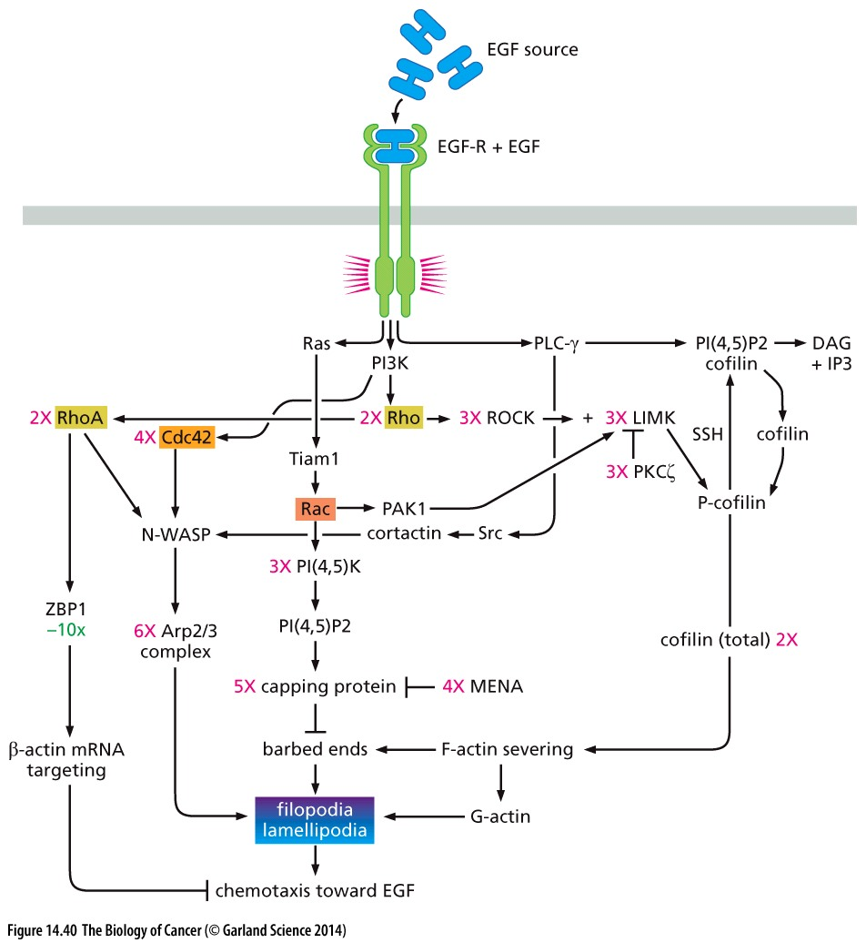
Figure 14.40 The circuitry mediating EGF-induced cell motility
Notes:
细节仅供参考

Slide 57
14.11 Metastasizing cells can use lymphatic vessels to disperse from the primary tumor

Slide 58
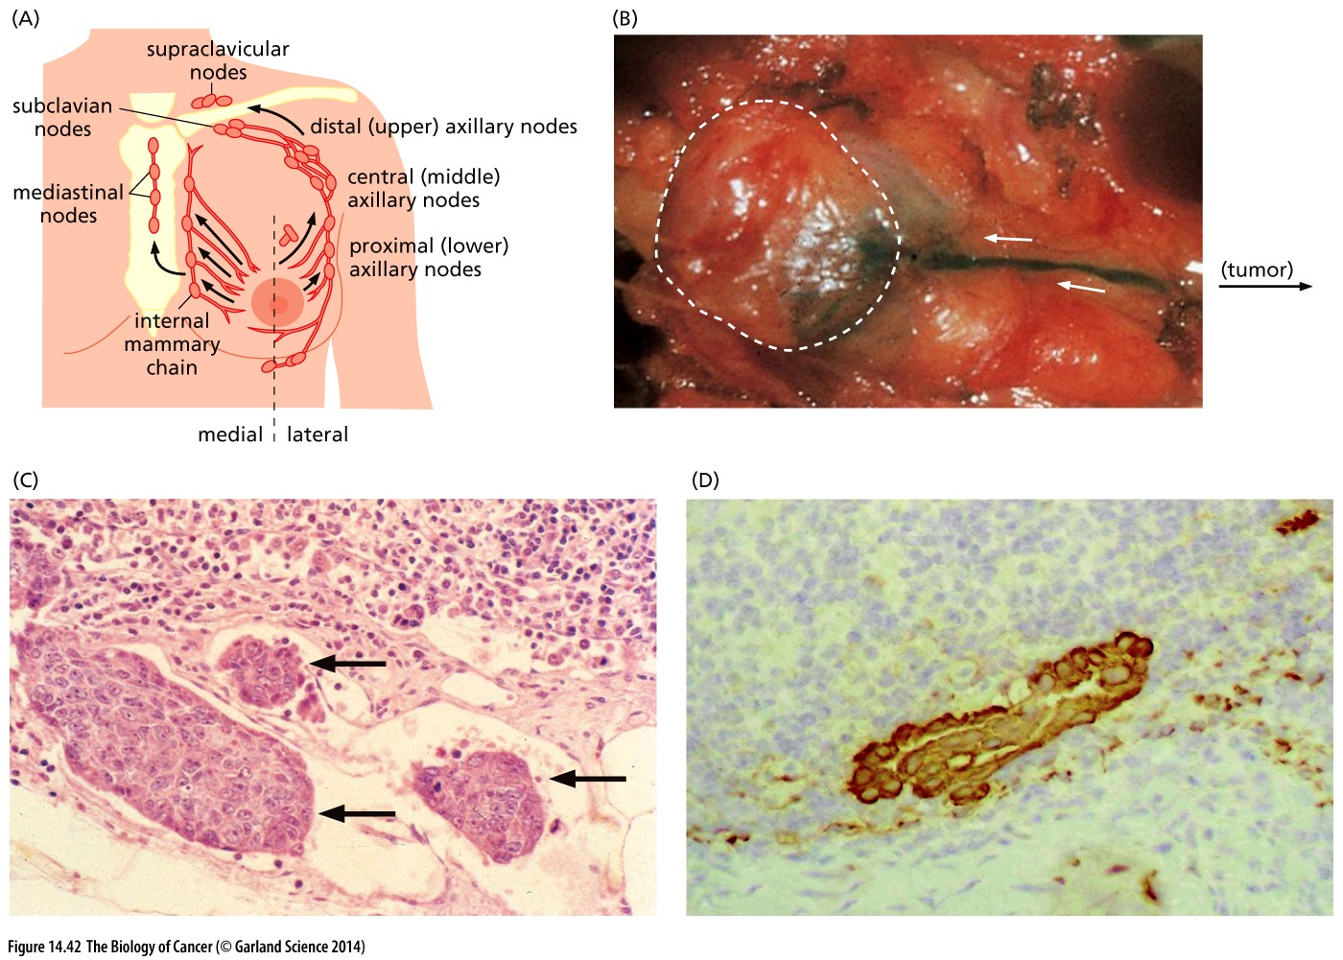
Figure 14.42 Draining lymph nodes（引流淋巴结） of the mammary gland
Lymph node tracing
micrometastases
Cytokeratin, epithelial marker
Notes:
乳腺癌淋巴结转移的示踪

Slide 59
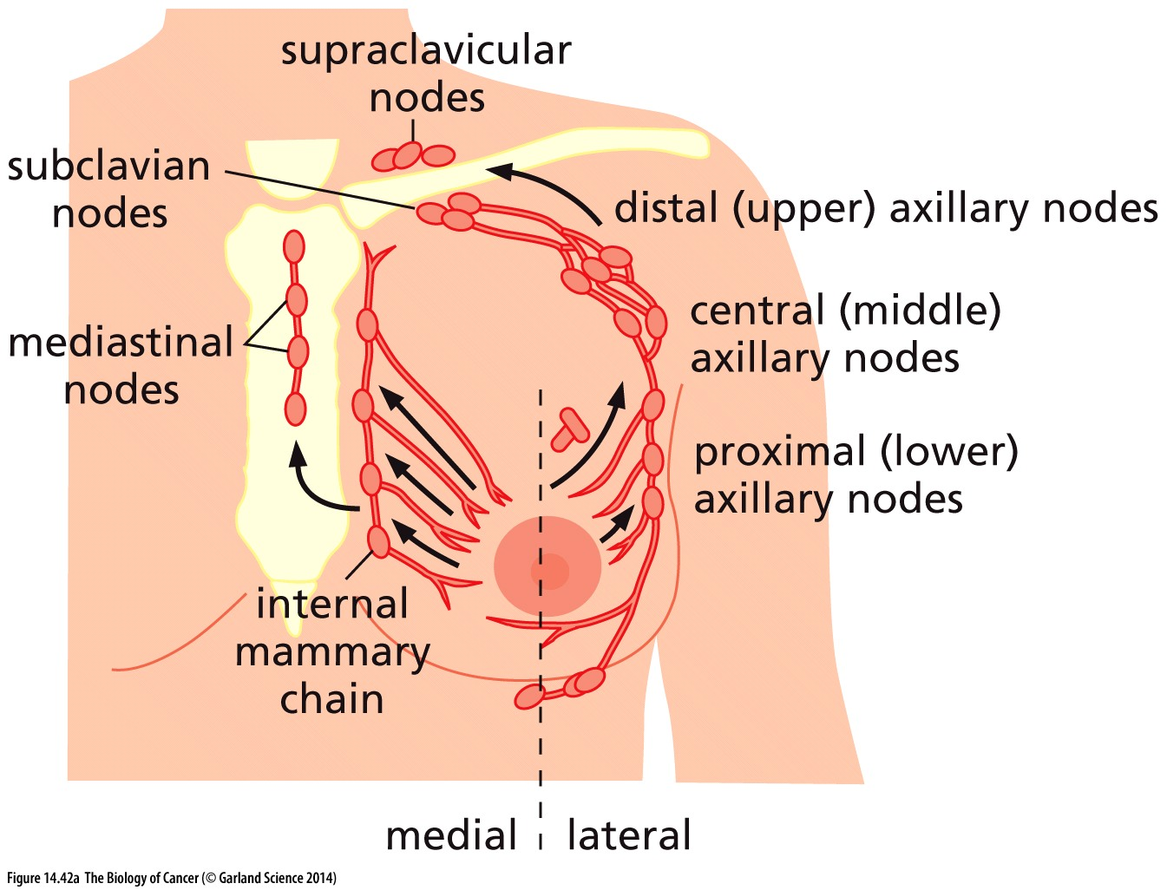
The lymphatic ducts (red) and the lymph nodes draining the breast (swellings along ducts) are initial sites of metastatic spread, carcinoma cells being carried there by the flow of lymph (arrows) leaving various sectors of the breast. Discovery of carcinoma cells in these lymph nodes, which is observed in more than 30% of human breast carcinoma patients at the time of initial diagnosis.

Slide 60
14.12 A variety of factors govern the organ sites in which disseminated cancer cells form metastases
The growth of micrometastases (<2 mm diameter) into macrometastases (>2 mm diameter) is clearly the key step in determining whether or not metastatic disease will ever develop. For example, 30–35% of the women diagnosed with primary breast carcinomas have thousands of micrometastases in their bone marrow, many composed of single cells or tiny clusters of cells, yet only half of these women will ever suffer a disease relapse triggered by the appearance of macroscopic metastases. Clearly, colonization (that is, the growth of micrometastases into macroscopic metastases) is an extremely inefficient process, and the vast majority of cells that end up forming small micrometastases never succeed in properly adapting to the tissue in which they have landed by spawning macrometastases.

Slide 61
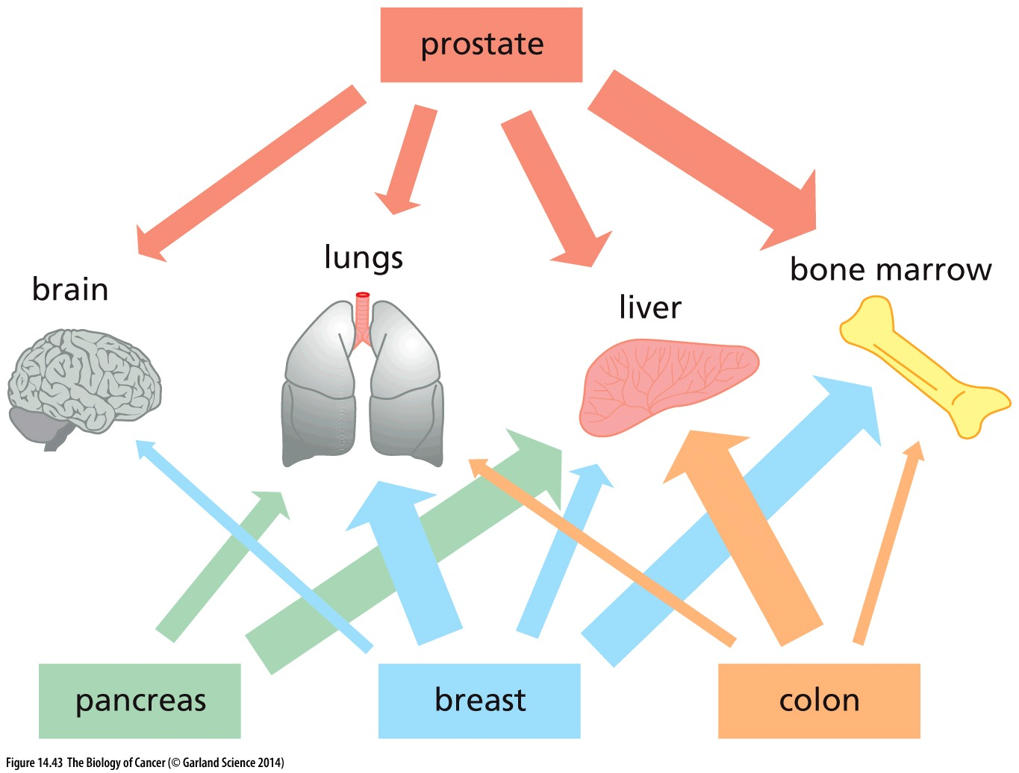
Figure 14.43 Primary tumors and their metastatic tropisms
In some cases, a tumor’s tendency to spawn metastases in one or another tissue reflects the abilities of the cancer cells from the primary tumor to adapt to (and thus colonize) the microenvironment of distant tissues; this likely explains the strong tendencies of prostate and breast cancers to generate metastases in the bone marrow. In other cases, the layout of the circulation may strongly influence the site of metastasis. For example, the high proportion of liver metastases deriving from primary colon cancers likely reflects the drainage via the portal vein of blood from the colon directly into the liver.

Slide 62
An extreme case of narrow metastatic tropism comes from the behavior of uveal melanomas（葡萄膜黑色素瘤）, which arise in the pigment cells of the eye. These cells characteristically metastasize to the liver, indicating that some component of the differentiation program of ocular（眼睛）melanocytes allows them to adapt far more readily to the liver microenvironment than to the microenvironments of other tissues.

Slide 63
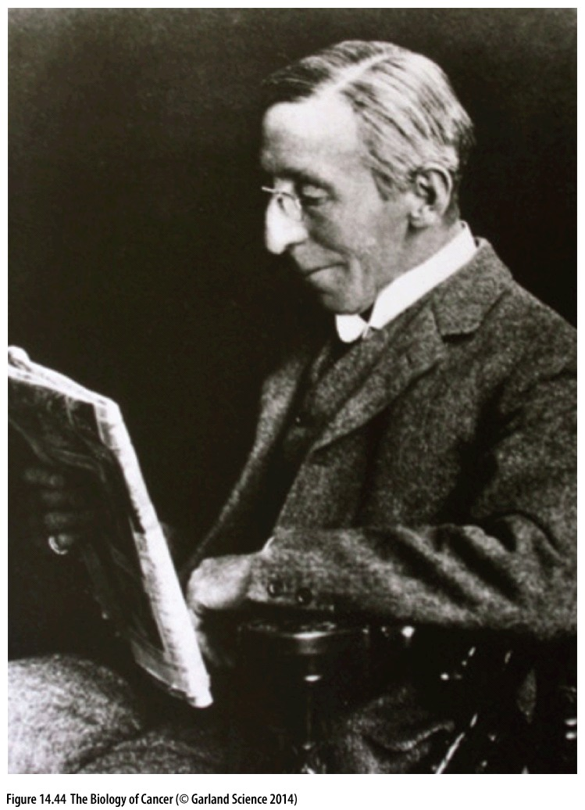
Figure 14.44 Stephen Paget
The British physician Stephen Paget (1855–1926) was the first to enunciate the “seed and soil” hypothesis, which states that the ability of a disseminated cancer cell to successfully found a metastasis depends on whether a distant tissue offers it a hospitable environment to survive and proliferate. (From I.J. Fidler, Nat. Rev. Cancer 3:453–458, 2003.)
矛盾现象：Contralateral (对侧的) metastases are relatively rare
Notes:
Breast cancer rarely metastasize into contralateral (对侧的) breast.

Slide 64
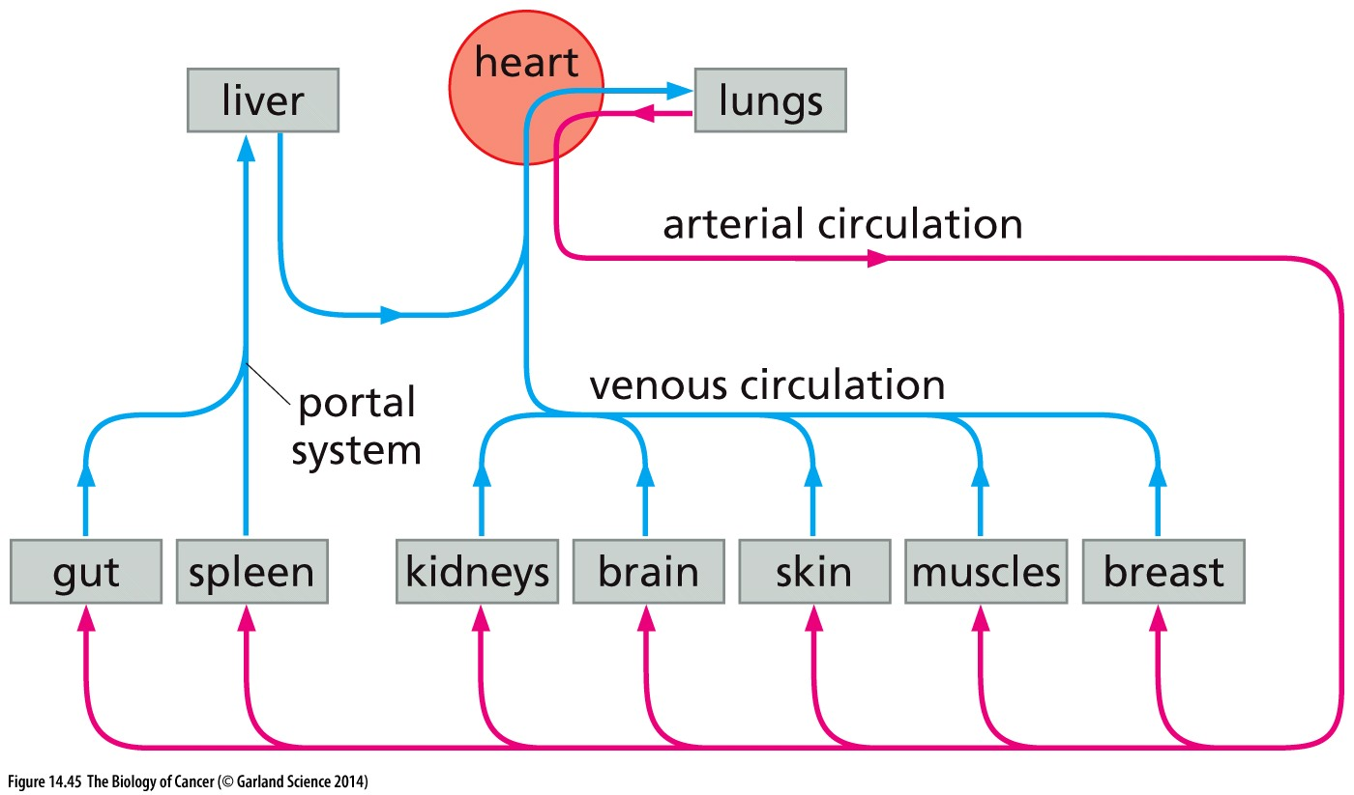
Figure 14.45 Portal circulation（门脉循环）and liver metastasis
While the venous systems of most tissues drain to the right side of the heart and thereafter into the capillary beds of the lungs, the veins draining the spleen and gut are organized differently, in that their venous blood empties directly into the liver via the portal circulation before being dispatched back to the heart. Consequently, vast numbers of metastasizing colorectal carcinoma cells are trapped in capillary beds of the liver within seconds of leaving the colon.

Slide 65
14.13 Metastasis to bone requires the subversion（破坏） of osteoblasts（成骨细胞） and osteoclasts（破骨细胞）

Slide 66
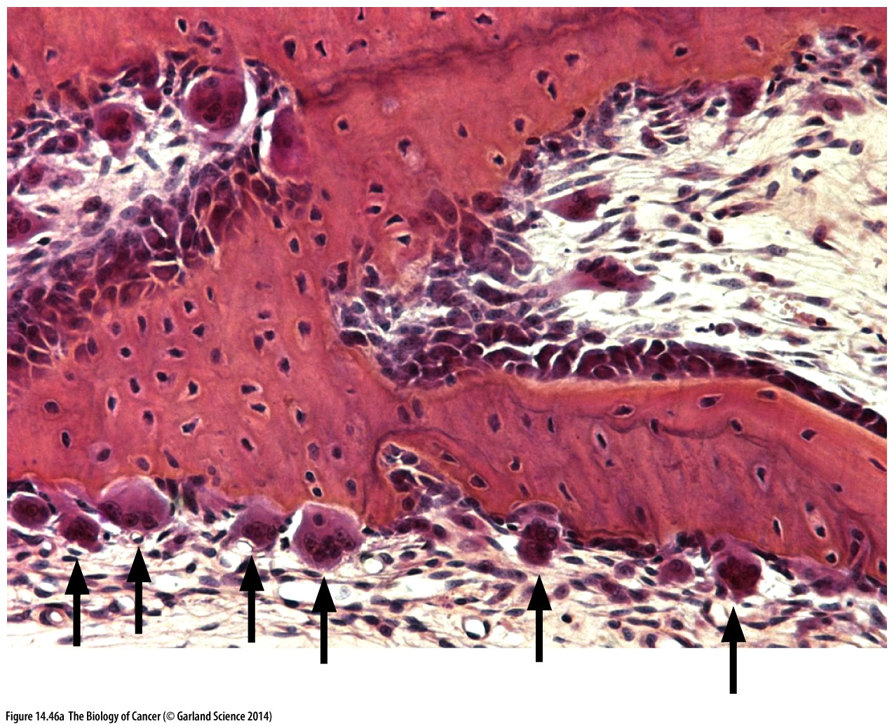
Figure 14.46 Bone degradation by osteoclasts
The degradation of bone, often termed resorption, depends on the complex actions of osteoclasts—large multinucleated cells deriving from the monocyte lineage that also generates macrophages. (A) This light micrograph shows osteoclasts (purple, arrows) excavating（挖掘） small pits in the surface of a mouse jawbone (pink).

Slide 67

Figure 14.47 Osteolytic and osteoblastic metastases

Slide 68

(D) In the iliac crest（髂骨） of the pelvis（骨盆） of a prostate cancer patient, the native bone (green-blue) can be readily resolved from the newly synthesized, still-poorly mineralized osteoblastic lesion (red), which is sometimes termed osteoid（类骨质的）. The osteoid is protruding into a mass of metastatic prostate cancer cells (dark purple nuclei).

Slide 69

Figure 14.48 Osteoblasts versus osteoclasts
(A) The physiologic balance between normal bone formation and resorption is created by signaling between osteoblasts, which assemble bone, and osteoclasts, which dissolve it.

Slide 70

Cancer cell and osteoclast induction
Notes:
具体机制仅供参考

Slide 71


Slide 72
14.15 Occult（隐蔽的）micrometastases threaten the long-term survival of cancer patients

Slide 73

Figure 14.50 Micrometastases and
clinical prognosis

Slide 74

Figure 14.51 Schedule of acquiring metastatic propensity The process of metastasis is the endpoint of multi-step tumor progression for many human tumors. This raises the issue of whether the tendency to metastasize is acquired late in tumor progression by a small subpopulation of cells or relatively early.
RNAs prepared from 64 primary adenocarcinomas (from various tissues) and 12 metastatic nodules of adenocarcinomas (arrayed across the top) were analyzed

Slide 75

Figure 14.53 Gene expression patterns and metastatic tropism（取向）

Slide 76

Figure 14.54 Genetic similarity between primary tumors and derived metastases
Gene expression array analyses can be used to classify different primary tumors and derived metastases according to their respective gene expression profiles (e.g., see Figure 14.51). If this is done, the degree of similarity between pairs of biopsies can be calculated using statistical methods.

Slide 77
思考题
1，简述肿瘤转移的步骤，其中最关键的步骤是什么？
2，什么是EMT？简述EMT在胚胎发育中作用，EMT在肿瘤转移中的作用

